Slide 1
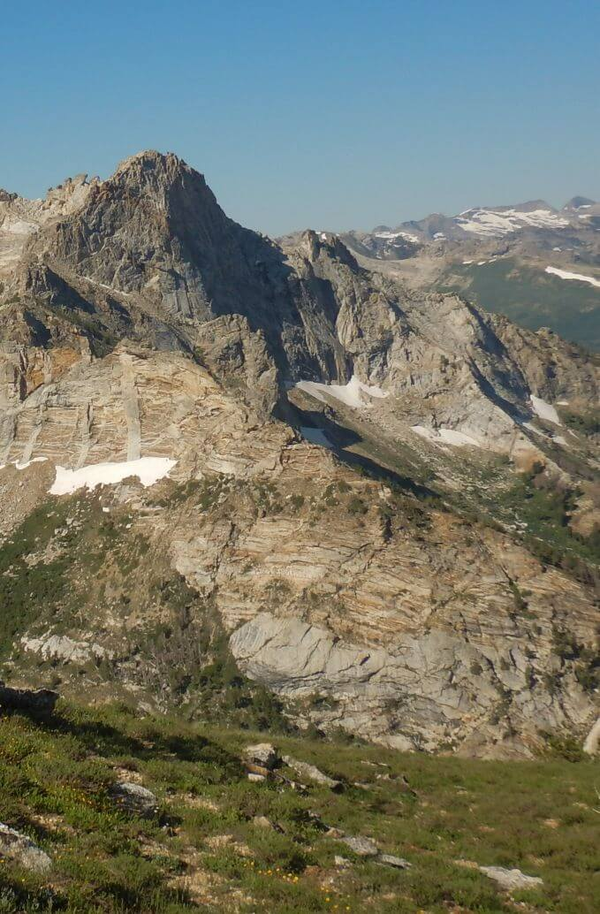
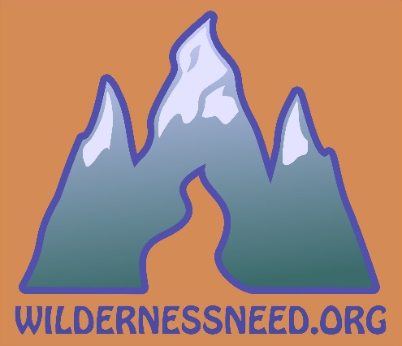
WILDERNESS SPIRITUALITY: Need for a Path
David C. Chojnacky, PhD
and
Cindy C. Chojnacky, MA
Hailey, Idaho USA
Ruby Mountains Wilderness, NV
Notes:
Slide 1…Introduction
Hi, we are David and Cindy Chojnacky from the USA and affiliated with The Wilderness Need Association, a non-profit we started in 2018.
We want to talk about wilderness spirituality…and our view that a spiritual journey requires a path.
Although the 1964 Wilderness Act does not include the term “spiritual”—the Act itself blended many political, religious, and cultural meanings into deep personal convictions about wilderness.
Many writers have associated Almighty, Divine, or God with wilderness. Everyday people also report spiritual connections to wilderness.

Slide 2
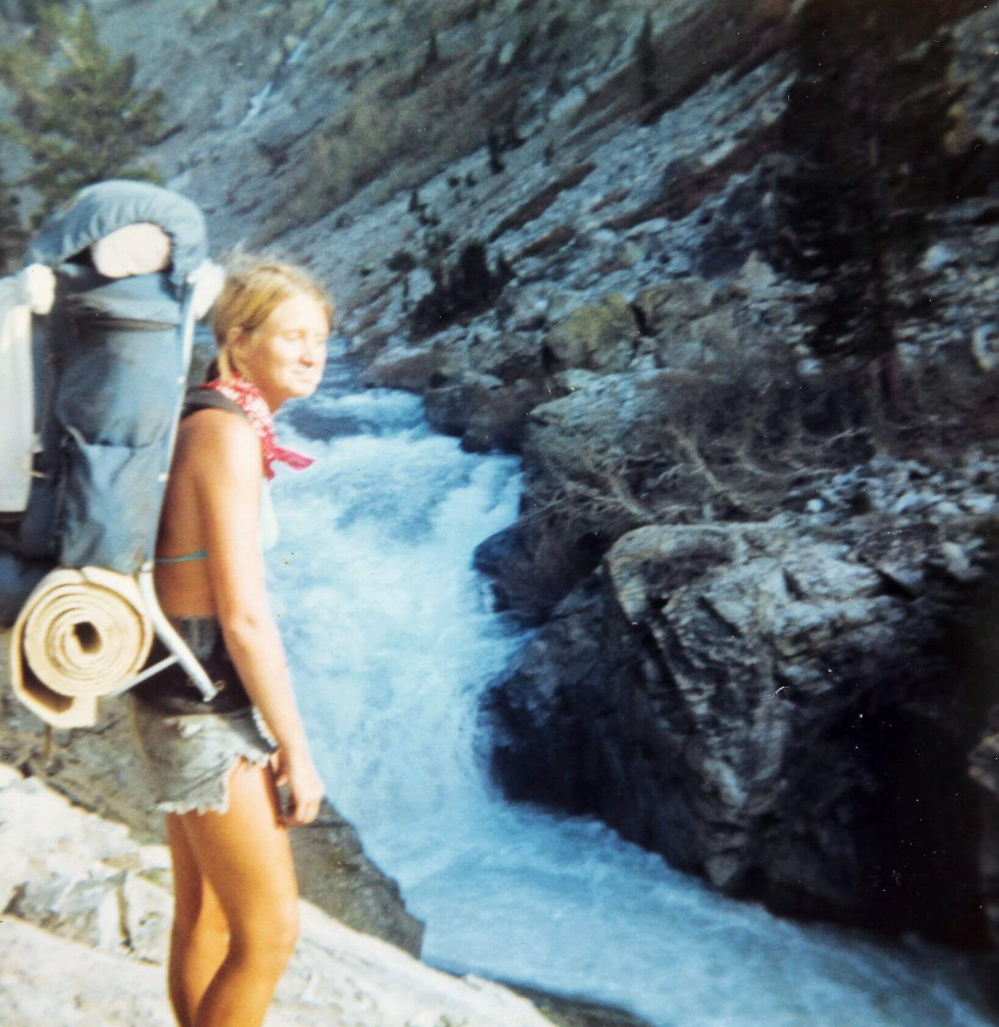
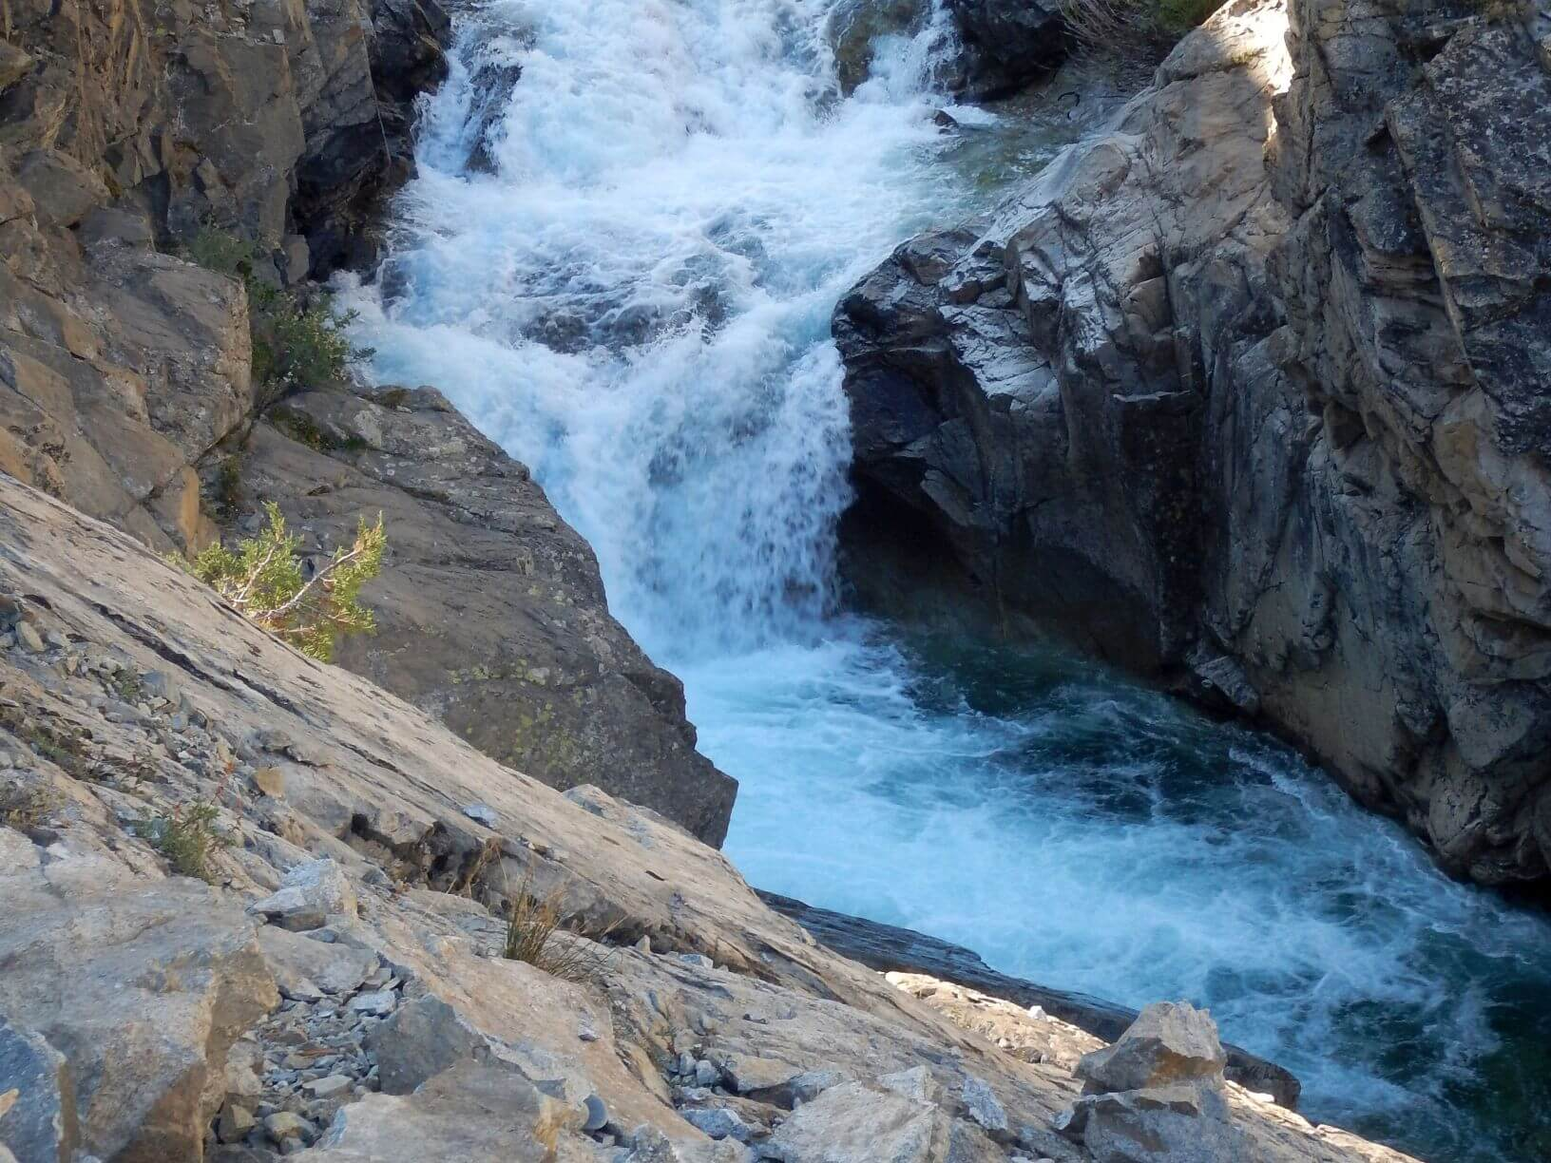
Background
Been exploring wild lands for decades
Cindy: studied journalism & political science; reporter, Forest Service: public affairs/ policy/District Ranger
David: studied forest biometrics; Forest Service, Virginia Tech; Int’l projects
Not Theologians but long Christian spirituality interest
John Muir Trail, Jun 1977
John Muir Trail, Sep 2017
Notes:
Slide 2…Our Background
We have been exploring wild lands for decades! Upper photo is on John Muir Trail—in Sierra’s Kings Canyon Wilderness—on our honeymoon in 1977; on a 2017 revisit, I was captivated again by same rushing chasm on South Fork San Joaquin River.
We are not theologians but have long interest in Christian spirituality including contemplative practices.

Slide 3
The Spiritual Values of Wilderness
Nagel (2005)—Notre Dame—overviews 3 eras: prior, during, and after 1964 Wilderness Act
“Prior to Wilderness Act”: Nagel traces Nash's (1967) ideas in Wilderness & the American Mind
Early writers Muir, Emerson, and others used spiritual language; later writers Leopold and Marshall did not
We think later writers simply avoided utilitarian cultural Christianity jargon
Notes:
Slide 3…We Frame Discussion Around Nagel’s Work
We used John Nagel’s paper on The Spiritual Values of Wilderness as key background source.
In the interest of time, I am going to skip some of the detail on my slides but if something catches your attention to feel free catch us afterwards.
One of Nagel’s sources made a big deal that early conservation writers used spiritual language but later writers did not…implying that the Wilderness Act lacked spiritual influence.
But we think these later writers simply avoided the utilitarian jargon of cultural Christianity.

Slide 4
Aldo Leopold
“We reached the old wolf in time to watch a fierce green fire dying in her eyes. I realized then, and have known ever since, that there was something new to me in those eyes—something known only to her and to the mountain”
Mexican gray wolf
Notes:
Slide 4…Wolf
For example, Aldo Leopold kills a wolf; the experience transforms him from thoughtless predator eradication to appreciating a dimension beyond, which we would call spirituality.
I quote… “We reached the old wolf in time to watch a fierce green fire dying in her eyes. I realized then, and have known ever since, that there was something new to me in those eyes-something known only to her and to the mountain.”

Slide 5
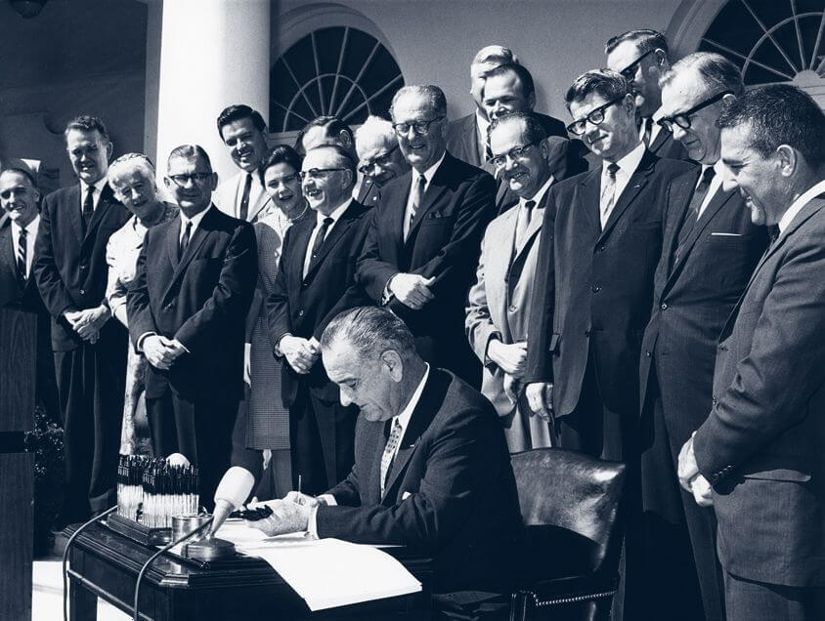
Nagel: “During Wilderness Act”
L. Johnson: “…a glimpse of the world as it was in the beginning, not just after we got through with it”
H. Zahniser represented by wife Alice
H. Humphrey & M. Udall: key leaders mentioned God or Divine
Frank Church
Notes:
Slide 5…Nagel: “During Wilderness Act”
I could say a lot about this historic photo of 1964 Wilderness Act signing ranging from bipartisan support to widows of key people that wrote and lobbied for the Act.
But I only quote President Lyndon Johnson, who signed the Act, “If future generations are to remember us with gratitude rather than contempt, we must leave them…a glimpse of the world as it was in the beginning, not just after we got through with it.”

Slide 6
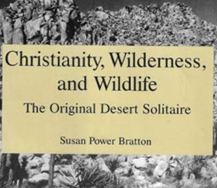
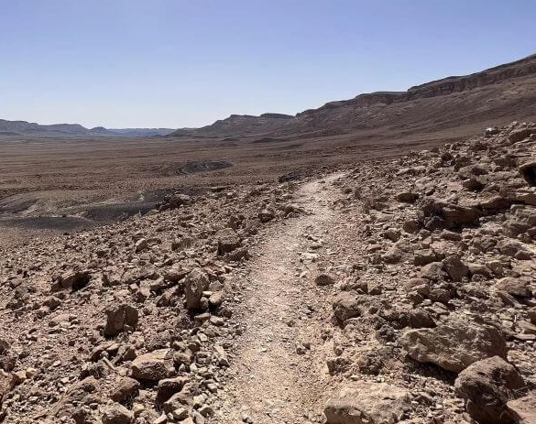
Nagel: “After Wilderness Act”
Elucidates rich motif wilderness concepts woven into sacred Christian texts
Wilderness wanderings in Negev Desert
Monastic & Celtic Christian literature highlights deep wilderness respect
No support from Christian writings for human right to dominate/exploit natural world
Negev Desert, Israel (today)
Notes:
Slide 6…Nagel: “After Wilderness Act”
After Wilderness Act, Nagel’s main source is Susan Bratton’s book Christianity, Wilderness, and Wildlife.
Bratton elucidates a motif of wilderness concepts woven into sacred Christian texts—missed by most readers of the Bible!
I want to call your attention to my last bullet point…Overall, Bratton finds no support from Christian writings for human right to dominate and exploit the natural world.

Slide 7
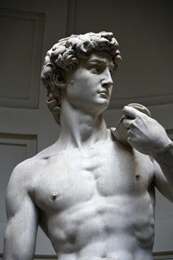
Psalms
Metaphor path, pathway or way occurs 100s times in Bible…implying right or known practice
In Psalms, 5 Hebrew words translated as path occurred 75 times (per Berkeley scholar)
Many Psalms attributed to King David
Walking on path intrinsic to spiritual understanding
Spiritual pilgrimages—journey to a sacred place—practiced by many religions today
Notes:
Slide 7…Psalms
Now I want to segue to our interest in wilderness trails by using a key Biblical metaphor: path, pathway, or way found hundreds of times in the Bible—particularly in Old Testament sacred texts.
I focused on Book of Psalms where the “path” metaphor often denoted a well-known direction toward a spiritual objective; ….therefore, walking a path seems intrinsic to spiritual understanding.
This corroborates with concept of a pilgrimage—commonly defined as a “journey to a sacred place”—practiced by many religions today!

Slide 8
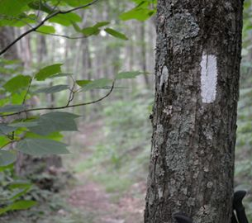
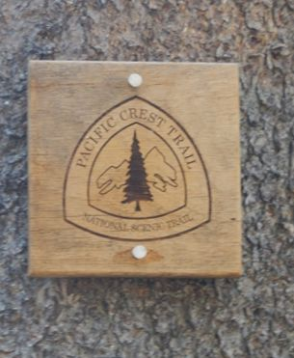
Thru-Hiking Pilgrimage
Two master’s theses connect spiritual pilgrimage to thru-hiking
Crowley (2018) surveyed on PCT “why they do it”; responses included sacred, changed me, more myself…
Ptasznik (2015) postulated thru-hiking as spiritual pilgrimage by analyzing three popular books—Walk in the Woods, Wild & A Sense of Direction—about Appalachian, Pacific Crest, & international trails, respectively
AT
PCT
Notes:
Slide 8…Thru-Hiking & Spiritual Pilgrimage
Two recent master’s theses helped us connect the spiritual journey to growing popularity of thru-hiking on long-distance trails through wild backcountry.
Hayes Crowley—writing on the Pacific Crest Trail— recorded many “spiritual” experiences in asking thru-hikers “why they do it.”
Responses included “sacred,” “it changed me," “(I was) looking for a purpose,” and "more myself."
Anna Ptasznik (Tiz nic) analyzed three popular books to correlate writers’ experiences to pilgrimage concepts on Appalachian, Pacific Crest, and international trails, respectively.

Slide 9
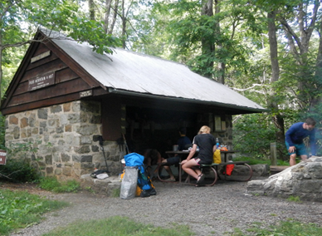
Our Wilderness Experience
We agree: wilderness & spirituality correlated; spiritual (path) journey & thru-hiking correlated
Wilderness: noisy civilization absent good place for spiritual journey
PROBLEM: “path” or trails little valued by wilderness powers to be
Thru-hike trails often avoid wilderness due to narrow agency interpre- tation of Wilderness Act
AT’s Pass Hut shelter just “outside” Shenandoah Wilderness
Notes:
Slide 9…Moving to Our Wilderness Experience
Cindy and I agree with conservation writers and politicians who saw correlation between wilderness and spirituality.
In meeting thru-hikers, we have found the metaphor path quite appropriate for their serene trail attitude—certainly what one would expect of someone on a spiritual journey.
BUT there is one problem…wilderness, while a good setting for a spiritual journey, often lacks good “paths.” Trails in wilderness are NOT that highly valued by wilderness advocates or agency managers.
Interestingly, thru-hike trails are often built outside or on boundary of wilderness.

Slide 10
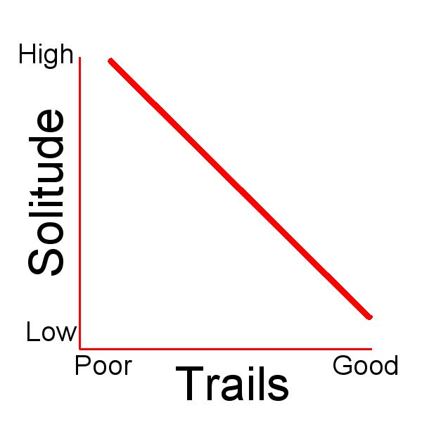
Key Finding…from past 10 years hiking 6,000 miles over 600 days on wilderness “trails”
Much wilderness rarely visited; some overused
Solitude-to-Trails Inverse: trails & information good, solitude is low; trails & information poor, solitude is high
Day hikers main wilderness users or some short trips
Backpacking shifting to thru-hiking on “well-marked” trails
Notes:
Slide 10…Our Finding
Recently we have backpacked in 91 wilderness areas across 14 states on “trails of sorts” in many cases.
From our experience, most wilderness acreage is rarely visited—AND a few places are over-visited.
We call this the Solitude-to-Trails Inverse: people flock to a few areas where information and trails are good, resulting in loving these places to death; but where trails and information are poor—no people.
Furthermore, we have found most wilderness users are day hikers to popular places.
More serious backpackers are shifting to thru-hikes on well-marked trails that skirt wilderness.

Slide 11
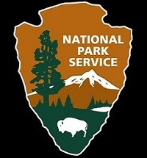
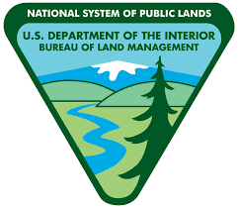
Wilderness Mngt. Agencies Culprit
None of four agencies very wilderness supportive
Culture and missions well-established prior to Wilderness Act
Forest Service & Park Service actually opposed Act
Wilderness Act interpretation a problem
Notes:
Slide 11…Wilderness Management Helped Create Use Problems
We think wilderness management agencies have helped create wilderness use problems.
None of the 4 agencies responsible for wilderness were very supportive of 1964 Wilderness Act, because their missions and culture were established years prior.
Park Service & Forest Service actually opposed 1964 Wilderness Act, while BLM and Fish & Wildlife Service had no lands in original Act.
Interpretation of Wilderness Act is also a problem…Cindy—more versed in policy than I—will address this in minute.

Slide 12
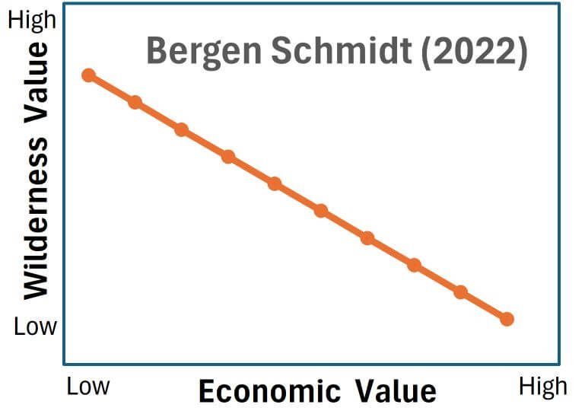
Wilderness Trails Data Gap
USGS initiated trail map decline: 1992 & 2009
No shortage of non-gov map info sources but business models drive products/profits—NOT necessarily wilderness trail needs
Notes:
Slide 12…Poor Wilderness Map Info
Another federal agency—U.S. Geological Survey—used to be gold standard for map information but stopped field-checking for trails in 1992 on its 7.5-minute (1:24,000 scale) maps; then in 2009 quit putting trails on maps.
Private hi-tech industry & non-profits have somewhat stepped into the map data gap.
But private business models are too revenue focused to provide comprehensive information and will never replace old USGS maps with single purpose of accurate info.
Graph from a thesis supports this point; wilderness and economic values opposites.
From my map experience, it takes much GIS effort to obtain, double-check, and modify map trail information for long-distance wilderness backpacks; on average, I spend about a half-day planning/preparing for each day on trail!
Now Cindy will talk about the Wilderness Act and share some stories of what we learned in specific wilderness areas.

Slide 13
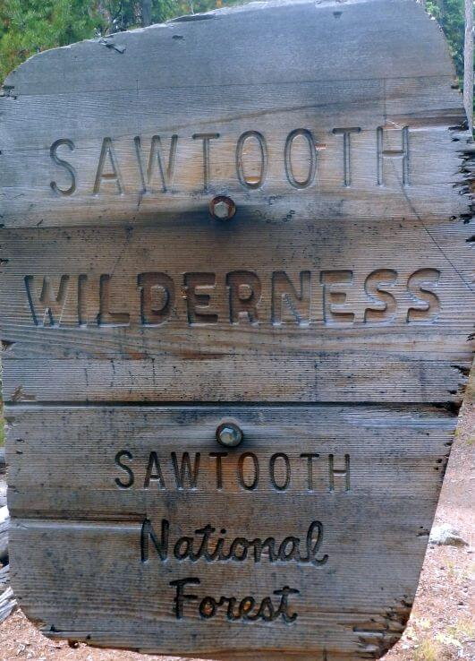
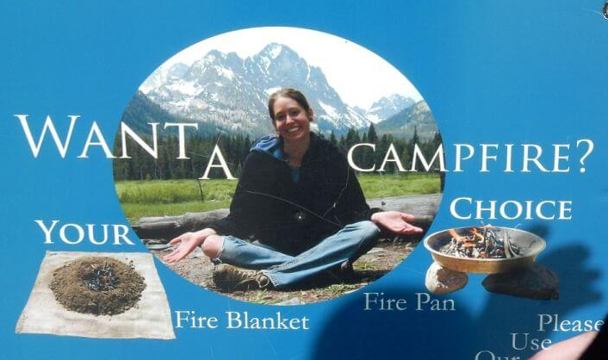
Wilderness Act Misunderstood
“Untrammeled” paradigm: sanctuary where people are problem
Wilderness purpose: people’s use and enjoyment
Sawtooth: poster child for wilderness misunderstanding
Notes:
Slide 13…Misinterpretation of Wilderness Act
Previous presenters have noted that Wilderness Act came out of a European colonial paradigm—that called potential wilderness “untrammeled” as if humans had never used them. It was also noted that wilderness and protected areas have been enforced with a “fortress conservation mentality.”
This viewpoint has dominated wilderness management and advocacy—focusing on maintaining some pure “untrammeled” sanctuary where people are the problem.
The Act actually states that wilderness is to be managed for the “use and enjoyment of the American people.” This is the purpose of wilderness—for people.
Sawtooth Wilderness, in our backyard, is poster child for misunderstanding Wilderness Act purpose. Sawtooth is well-known & overused with limited trails and only a few flat lakeside campsites…Forest Service could create more campsites on slopes away from lakes & expand trails by marking the best user-made routes, instead knocks down fire circle rocks and tells visitors to use “firepans”, not campfires. I have never seen a “firepan.”

Slide 14
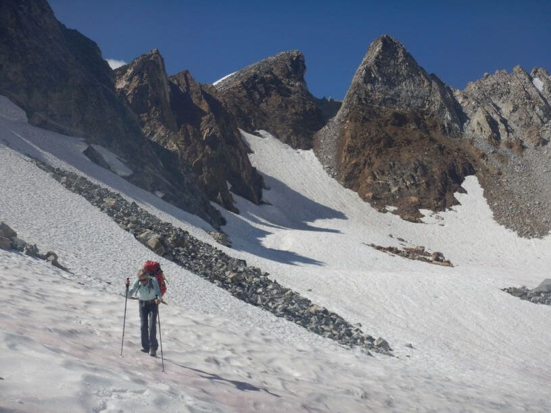
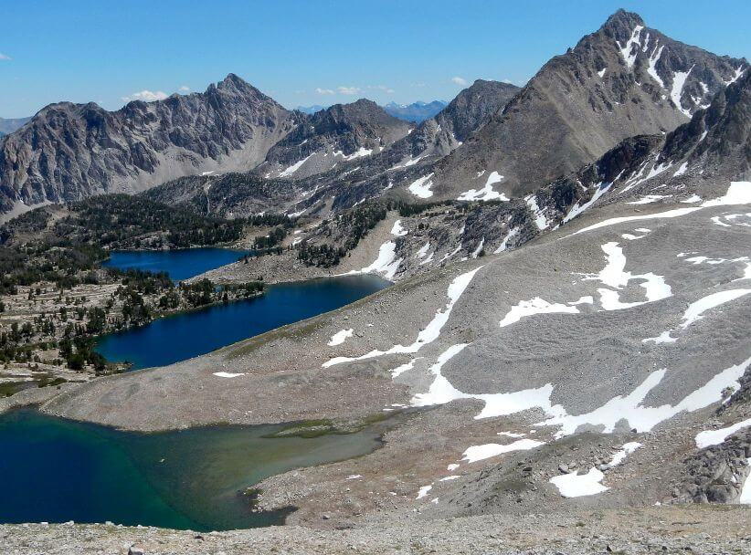
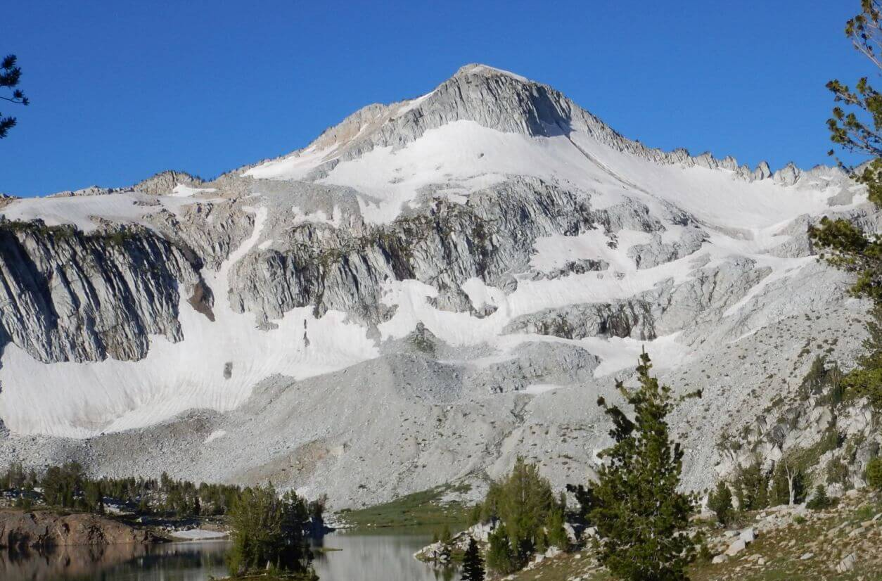
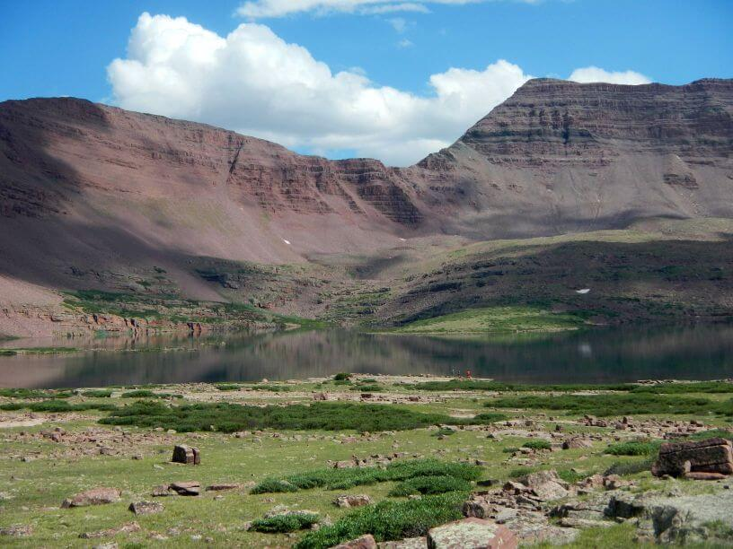
Rock & Ice Wilderness
John Muir, CA
Cecil D. Andrus-White Clouds, ID
Eagle Cap, OR
High Uintas, UT
Notes:
Slide 14…Rock & Ice Wilderness Areas
Now some examples from our many recent wilderness experiences…mostly trips designed to revisit areas hiked in our younger days. Given time limits, I will highlight one story for each type of wilderness. I’ll be happy to share war stories about other areas if you catch me after the session.
John Muir one of 3 wilderness we visited on loop in Sierras. Only a few days into our trek did we realize part of our loop followed the popular John Muir Trail (JMT).
Met dozens of southbound JMT hikers between Yosemite & Mt. Whitney, but very few on parallel routes like this one.

Slide 15
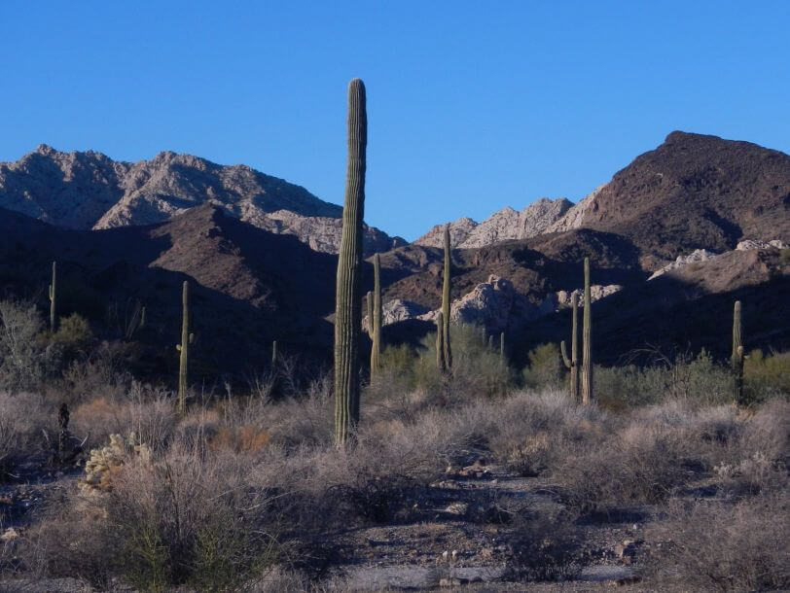
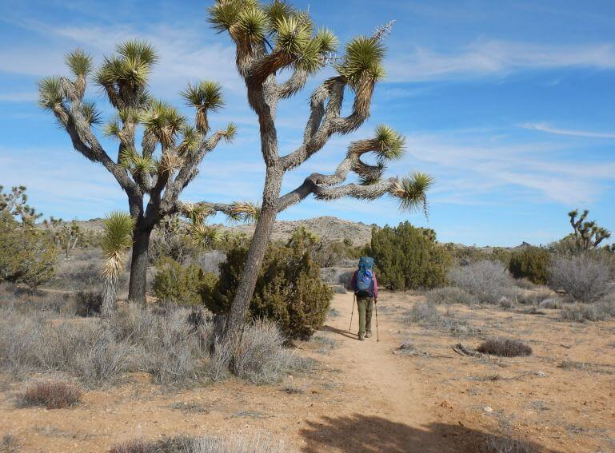
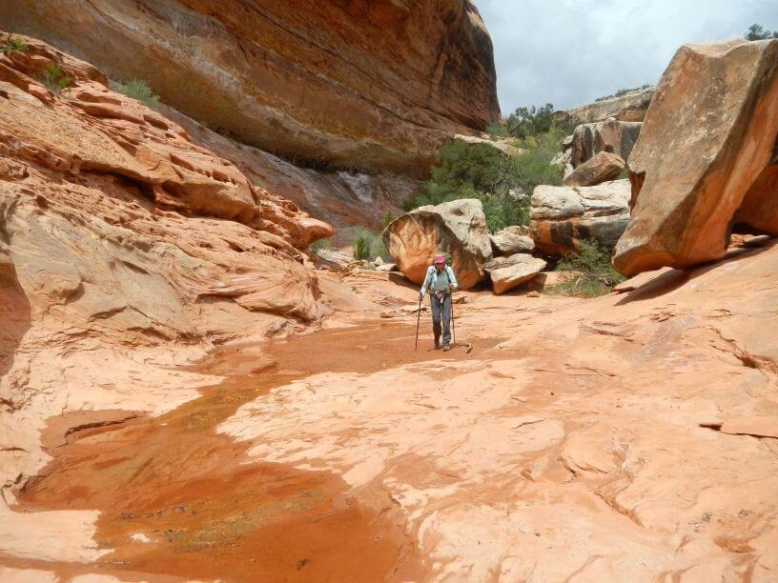
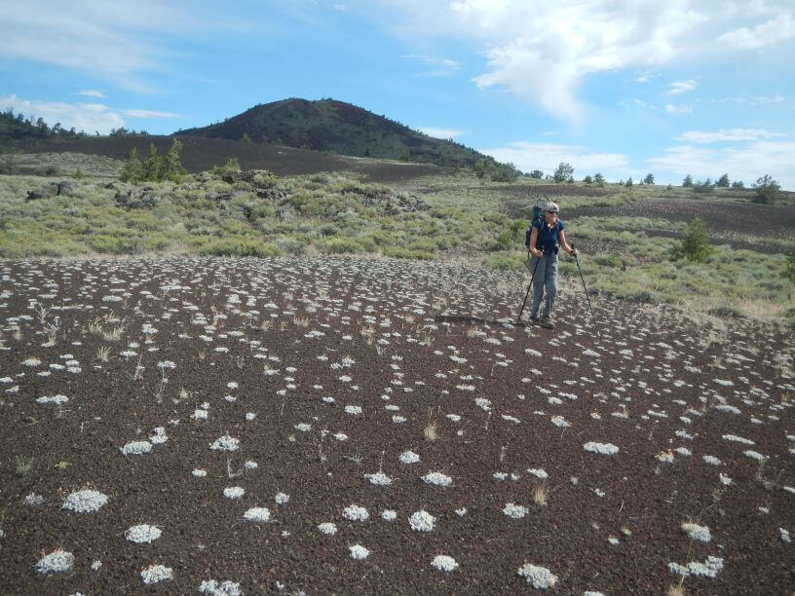
Desert Wilderness
Cabeza Prieta, AZ
Joshua Tree, CA
Grand Gulch (WSA), UT
Craters of Moon, ID
Notes:
Slide 15…DesertWilderness Areas
I’ll focus on Grand Gulch Wilderness Study Area—managed by Bureau of Land Management—and famous for Ancestral Puebloan ruins.
When we visited in 1980s, BLM had only sketchy trailer; now a brand new visitor center. But no hiking info other than paper handout on finding ruins.
This funnels most visitors into upper canyon for short loop. We later learned from online posts there were other loop options using side canyons—could reduce congestion if people know about these options.
We met a BLM Wilderness ranger, mainly concerned with knocking down cairns (rock marker) to routes on banks avoiding flooded main canyon, she apparently thought multiple user routes “more wild” than one good route.

Slide 16
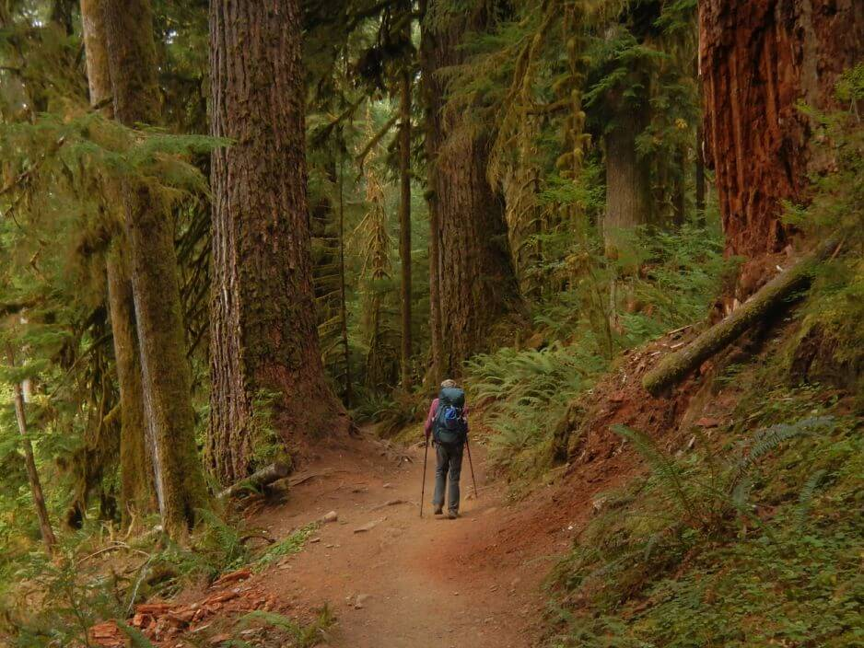
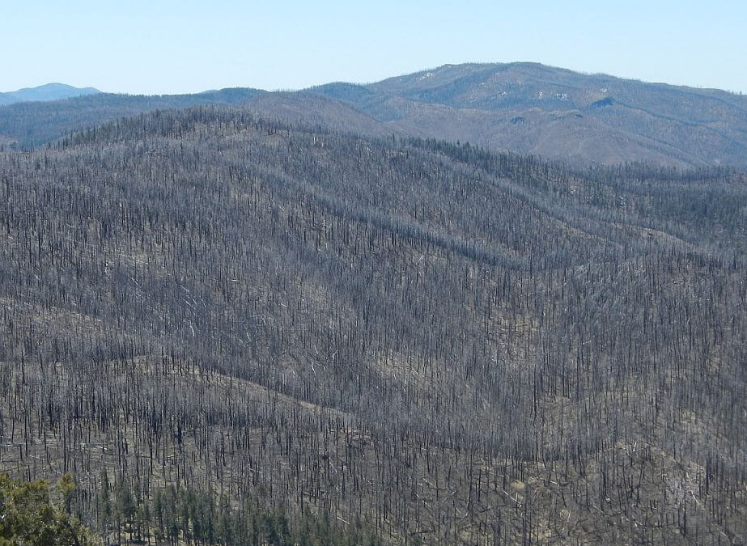
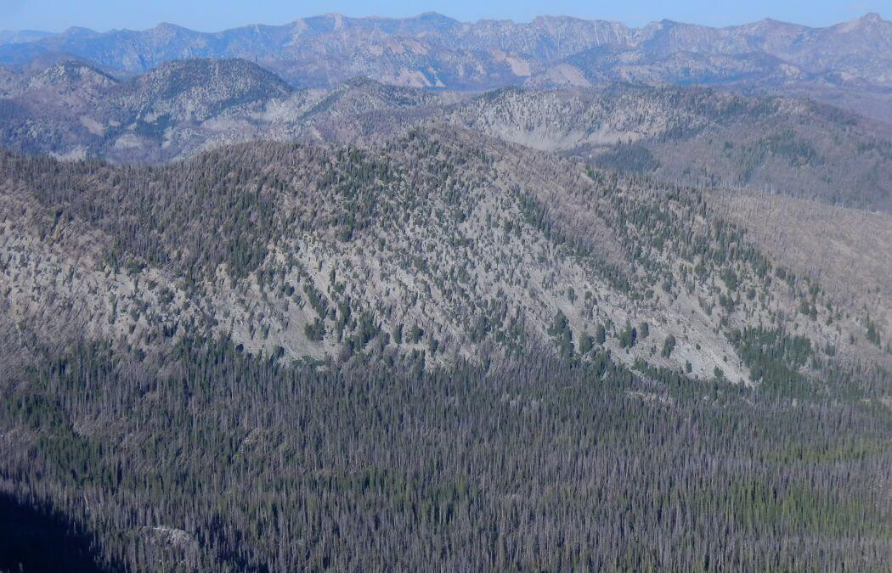
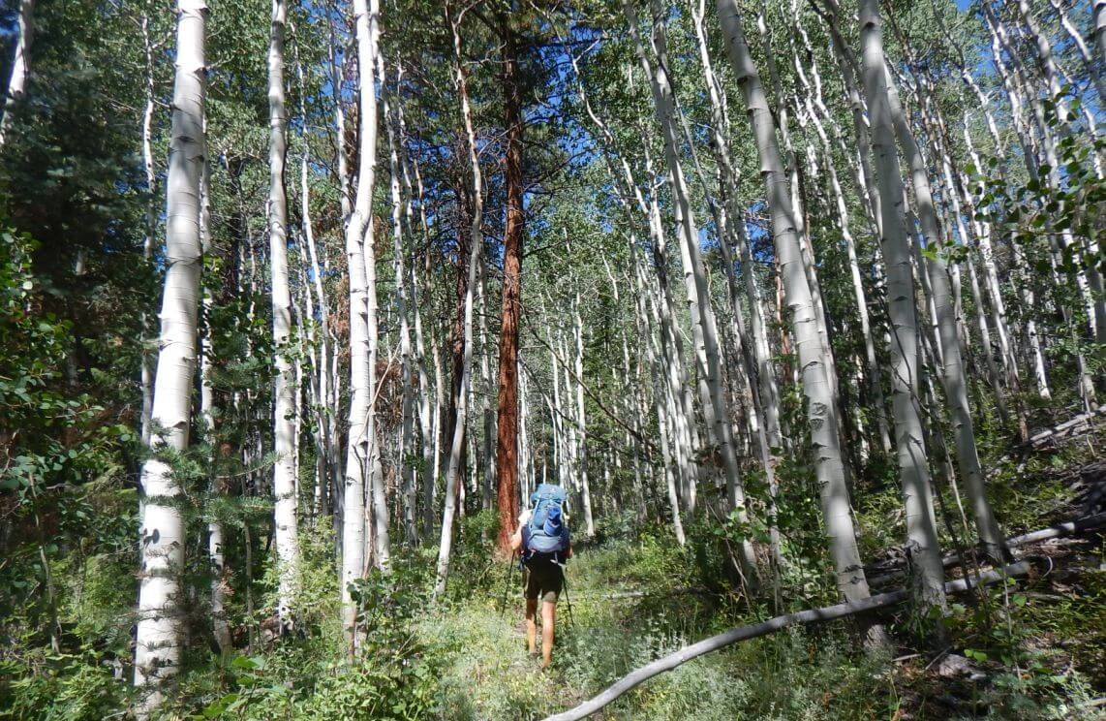
Forested Wilderness
Olympic (Daniel J. Evans), WA
Aldo Leopold, NM
Frank Church-
River of No Return, ID
Mount Moriah, NV
Notes:
Slide 16…Forested Wilderness Areas
Western forested wilderness are now more challenging to backpack because of trail damage from recent mega-fires.
For example, Frank Church-River of No Return is losing its huge 2600-mile trail system to downed logs.
Over 10 days, we saw no one except near one access road, people at a fly-in ranch, and the dozens of rafters on the Middle Fork Salmon River.

Slide 17
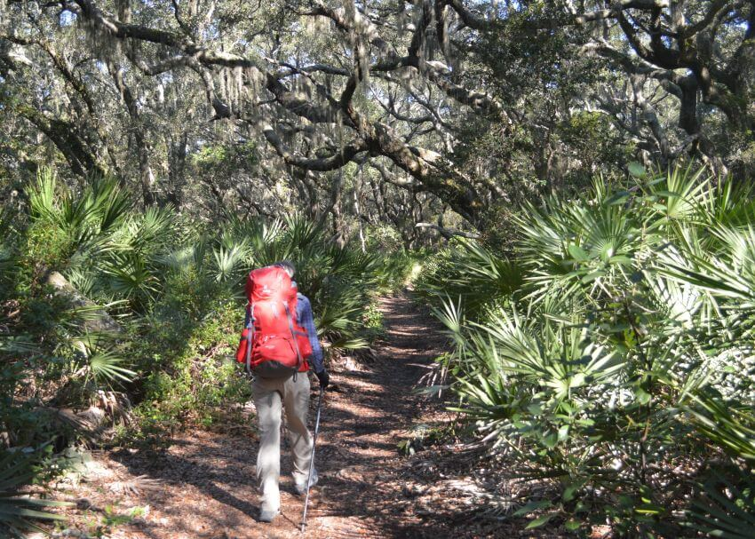
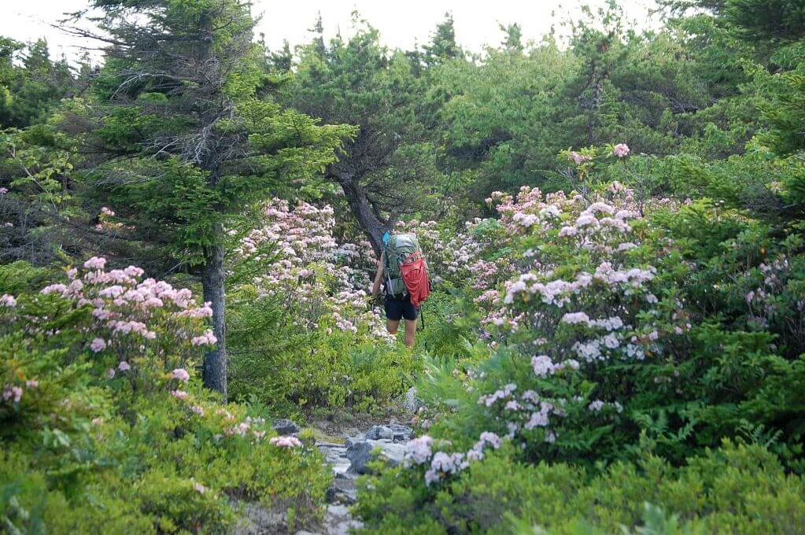
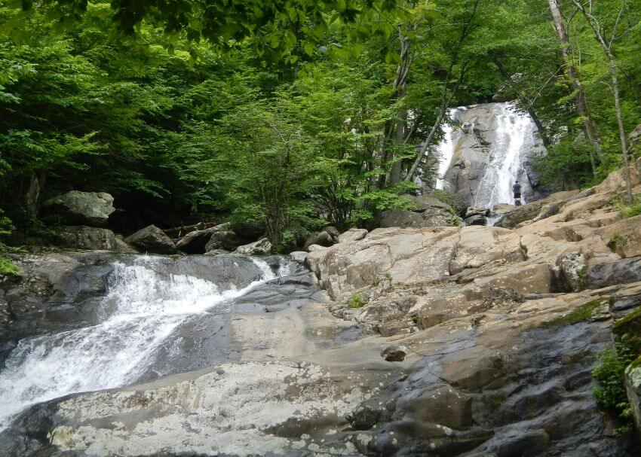
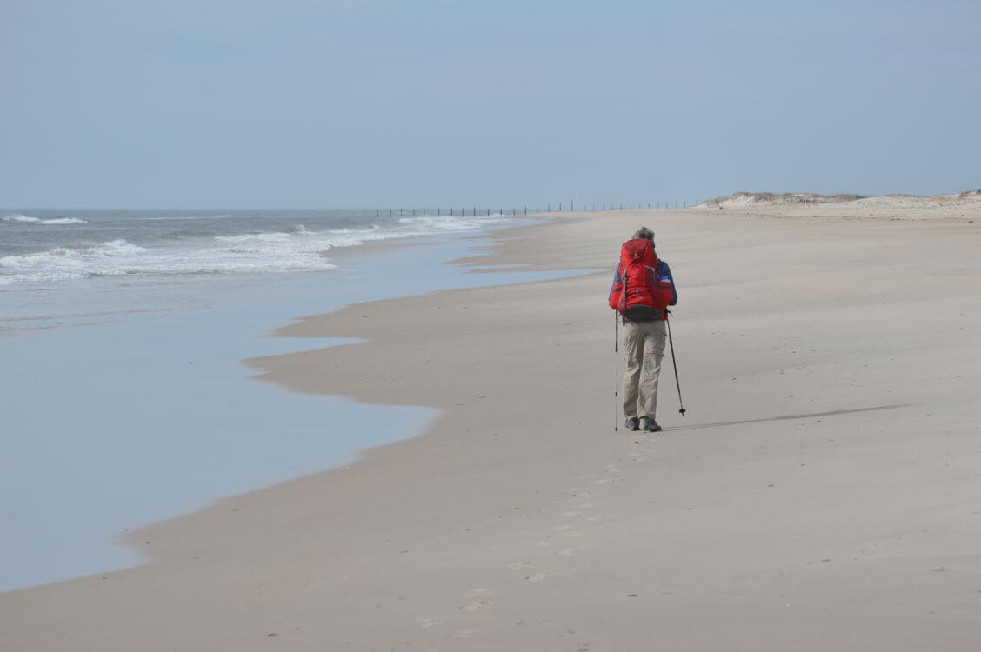
Eastern U.S. Wilderness
Cumberland Island, GA
Roaring Plains West, WV
Assateague Island (WSA), MD
Shenandoah, VA
Notes:
Slide 17…Eastern U.S. Wilderness
Little federal land in eastern U.S., but these offer rare glimpse of eastern U.S. before development.
Shenandoah Wilderness is Virginia’s largest—40 % of Shenandoah NP is wilderness with 500 miles of trails but few backpackers.
Park Service signs and maps focus on day hikes from Skyline Drive on crest of the mountains which draws 5 million annual vehicle visitors.
Appalachian Trail follows crest of the park but mostly outside wilderness parallel to Skyline Drive.
We used parts of AT to connect wilderness loops. Our joke was: you would see or hear someone within 3 minutes on the AT but generally solitude when more than a few miles from wilderness boundaries.

Slide 18
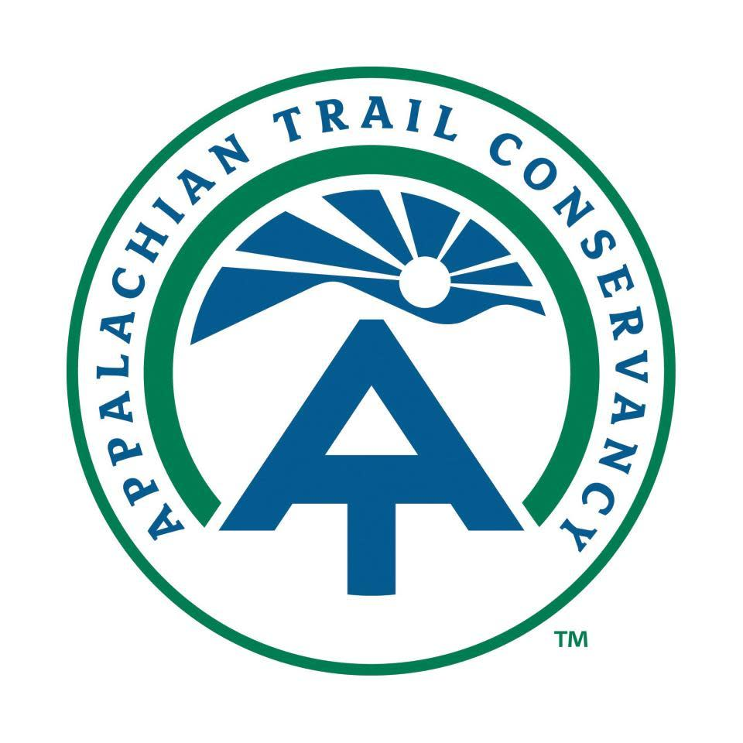
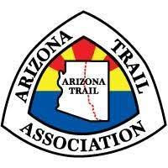
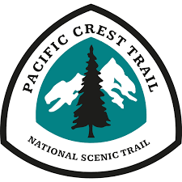
Wilderness Entity
We think trails are needed for wilderness spiritual experience
New wilderness entity could guide future management
How would this work? …perhaps thru-hike trails organizations offer model
Notes:
Slide 18…Wilderness Entity
We think trails are needed for undistracted experience of wilderness spirituality.
But trails are diminishing in many wilderness areas, with fewer overnight visitors and more day hikers and “thru hikers” on the edge of wilderness.
Perhaps a new Wilderness Entity could refocus on wilderness purpose for visitors while working cooperatively with land management agencies and original indigenous users.
Thru-hike organizations such as Appalachian Trail Conservancy and Pacific Crest Association might be good model. They offer info/support for thru-trail while allowing federal and state management agencies to administer land areas these trails cross.

Slide 19
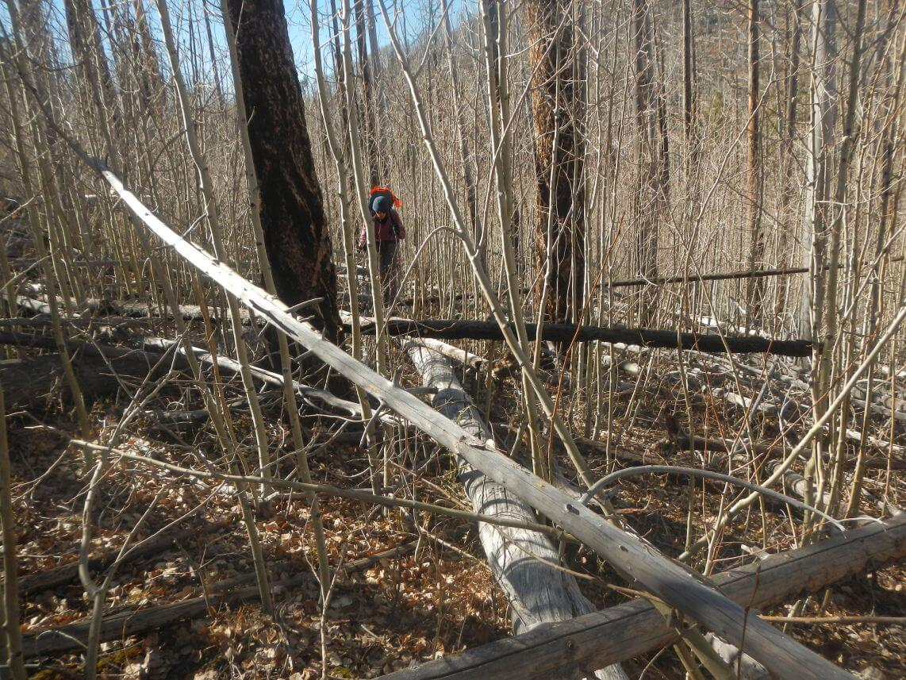
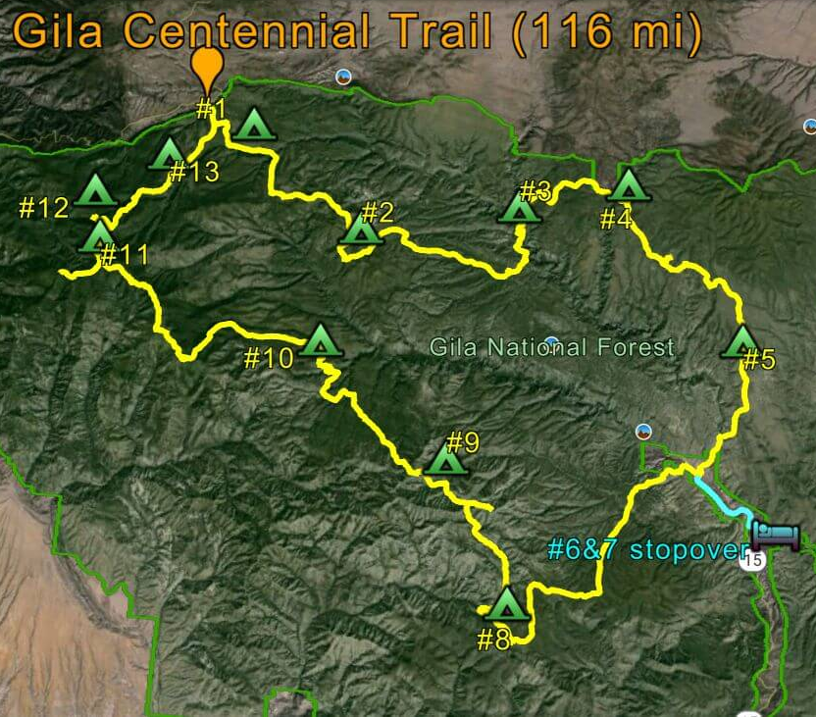
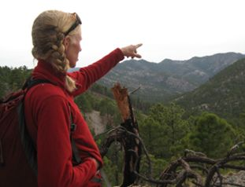
Gila Wilderness Example
”Trail” 11 years after fire
Melissa
Notes:
Slide 19…Gila Success
I will close with a small-scale model of successful wilderness management for trails on the Gila Wilderness in New Mexico.
A former Forest Service trail crew member—Melissa Green—has partnered with non-profit New Mexico Back Country Horsemen, volunteers, and Forest Service to maintain and restore 100s of miles of Gila Wilderness trails.
Last November, David and I hiked the newly established Gila Centennial Trail that circles and commemorates the nation's oldest wilderness. Most sections are good, some recently improved by Melissa’s work. We lost half a day on last section still damaged from 2012 fire.
The photo of me crawling over a log illustrates our point that poor trails strongly “distract” the wilderness visitor.

Slide 20
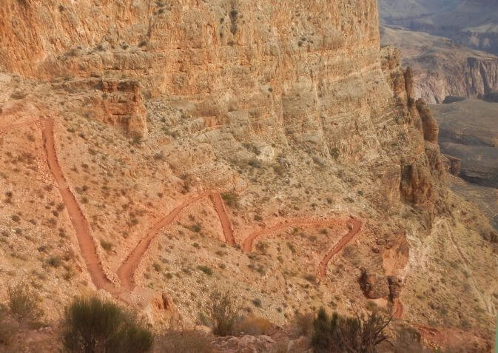
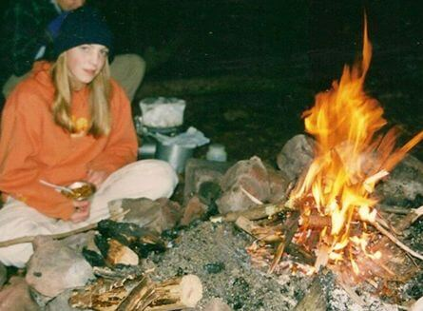
Bottom Line
Wilderness spirituality not succinctly defined but people drawn to wild lands
Trails fundamental to experiencing wilderness spirituality
With current wilderness management, will we provide paths for next generation?
Would 60,000 annually hike to bottom Grand Canyon w/o trail?
Raised daughter w/ wilderness trails...her generation’s kids?
Notes:
Slide 20…Bottom Line
Spirituality is rooted in mystery. But there is a draw to wilderness for many people.
Trails are key for an undistracted wilderness spirituality experience.
But with current wilderness management, will we still provide paths for the next generation?

Slide 21
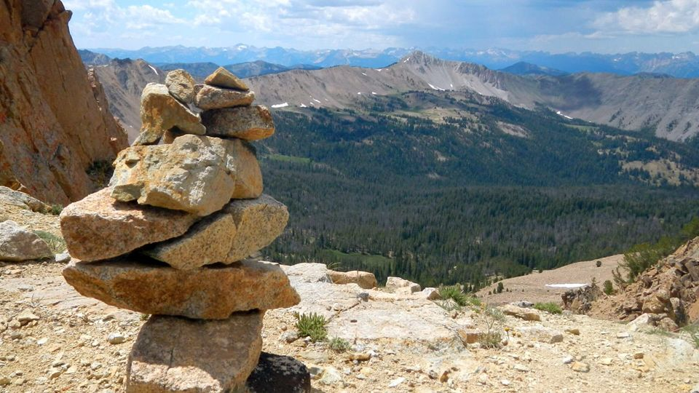
Questions/Comments?
Notes:
Slide 21…Questions/Comments
If you have questions or comments we would love to talk afterwards.

