Slide 1
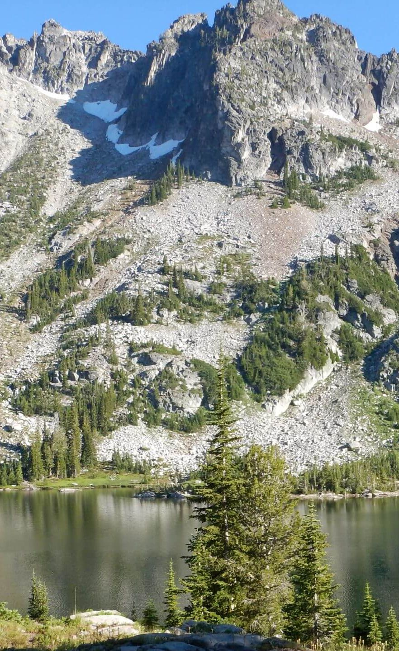
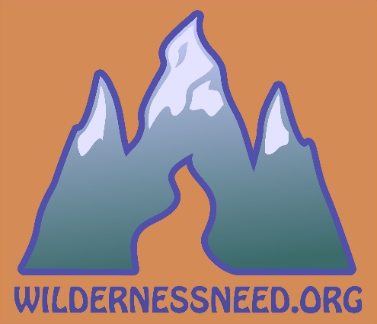
WILDERNESS: Why we go, What we see, Where it’s headed
David C. Chojnacky, PhD
and
Cindy C. Chojnacky, MA
Hailey, Idaho USA
Eagle Cap Wilderness, Oregon
Notes:
Slide 1…Introduction
Hi, welcome to our presentation. I am David Chojnacky and this is my colleague Cindy Chojnacky who will speak a little later.
We are from the USA.
We are affiliated with The Wilderness Need Association—a small non-profit that we started in 2018.
We want to talk about why we go to the wilderness and what we are finding.
First, some background on the USA’s National Wilderness Preservation System.

Slide 2
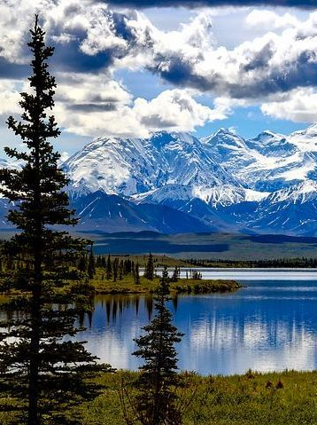
USA National Wilderness Preservation System
803 wilderness areas
45 million ha
5% of USA
Half in Alaska
Wilderness within larger protected areas
Important & contentious
Denali Wilderness, Alaska
Notes:
Slide 2…USA National Wilderness Preservation System
There are 803 wilderness areas in the National Wilderness Preservation System covering 45 million hectares.
Wilderness amounts to about 5% of USA.
A little more than half is in Alaska.
Wilderness is generally located within larger protected areas like national forests, national parks, and other federally managed lands.
Even though it covers a relatively small area, USA wilderness is important and also very contentious.
Part of the reason is grounded in the legal origins of USA wilderness: The Wilderness Act of 1964.

Slide 3
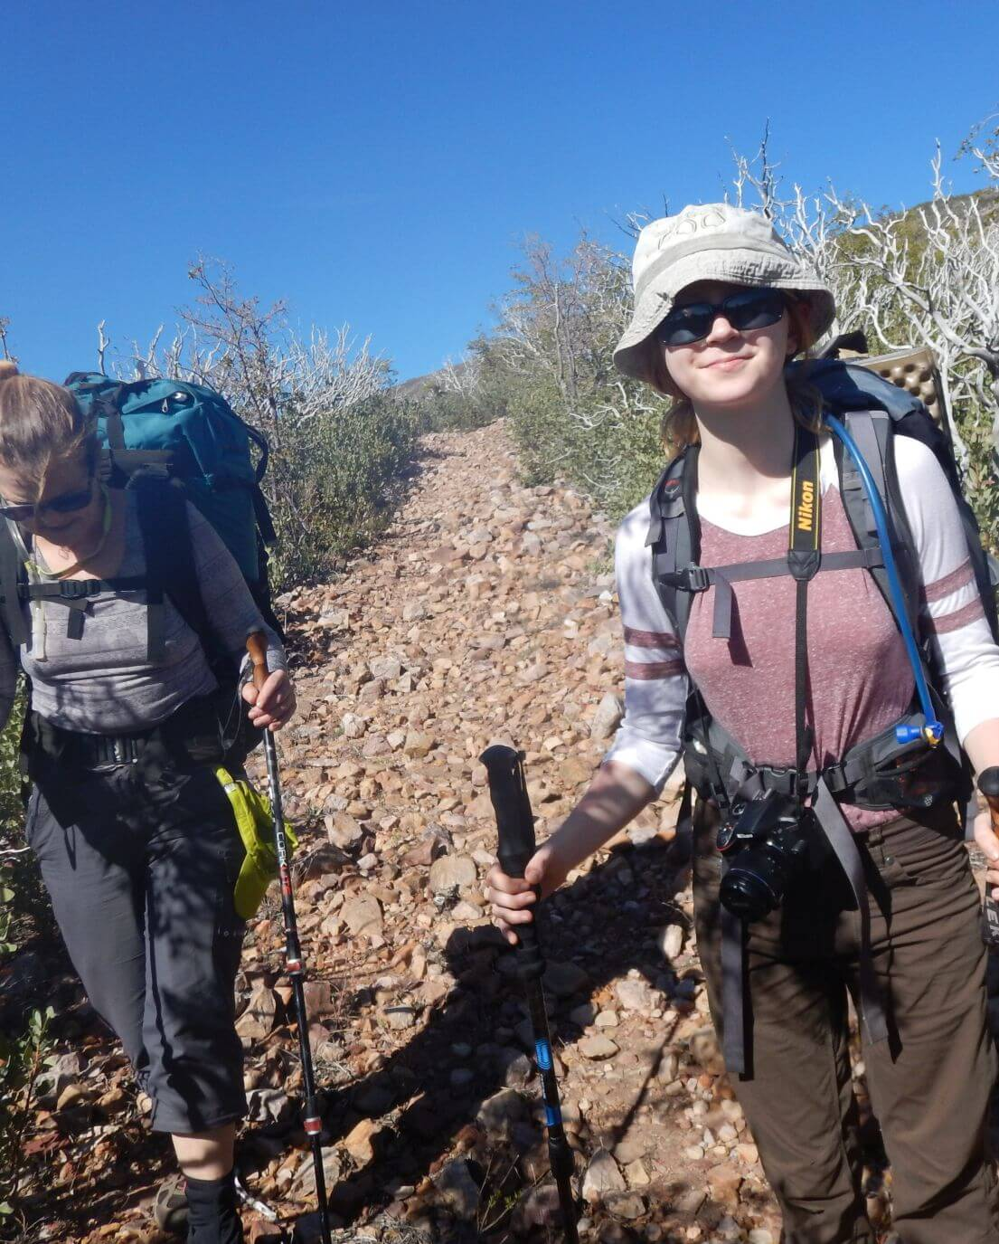
Purpose of Wilderness
1964 Wilderness Act
Surprising purpose: …“use and enjoyment of American people in such a manner as will leave them unimpaired”…
Tension: wilderness experience & character
Mazatzal Wilderness, Arizona
Notes:
Slide 3…Purpose of wilderness
The Wilderness Act of 1964 states a surprising reason for creating wilderness.
The preamble to the Act states that Congress is establishing this unique wilderness system to: “secure for the American people…the enduring resource of wilderness.”
It further states that Wilderness areas “…shall be administered for the use and enjoyment of the American people in such manner as will leave them unimpaired for future use…” this is an excerpt from Wilderness Act SECTION 2. (a).
So we see in this law a balance between wilderness use and enjoyment (or “wilderness experience”) and preserving wilderness lands “unimpaired” (or “wilderness character”). A tension between wilderness experience and maintaining wilderness character was built into the law.

Slide 4
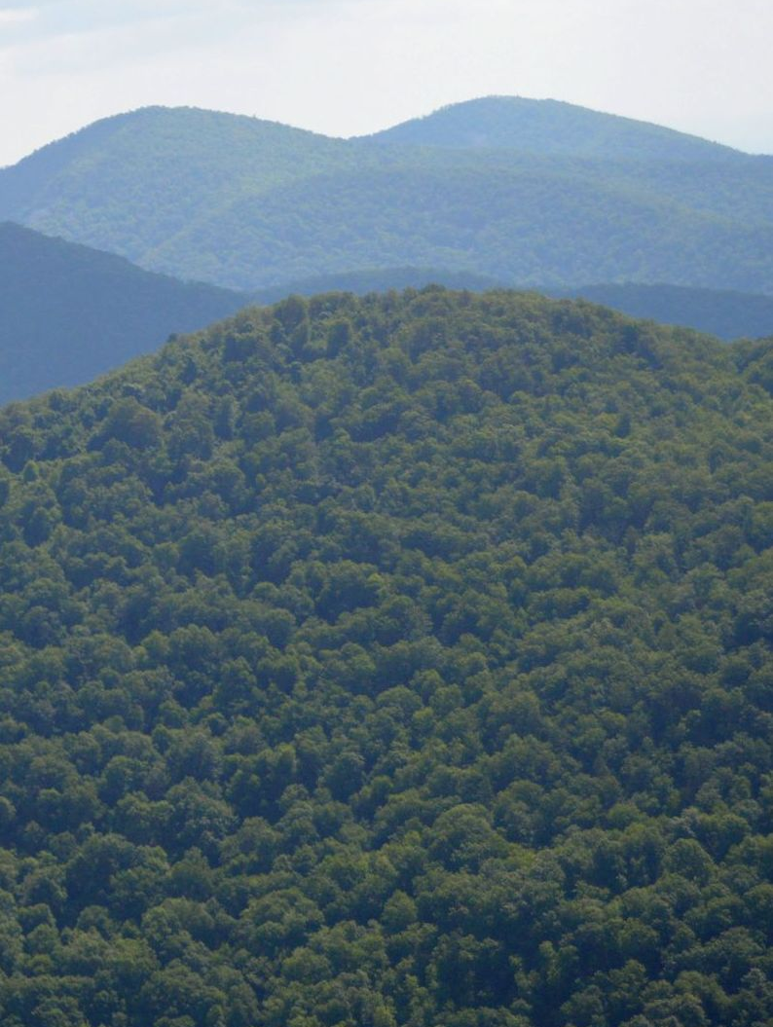
Definition of Wilderness
“A wilderness…is an area…untrammeled by man, where man himself is a visitor who does not remain”
Humans not dominant yet managed for people
Result: confusion!
Shenandoah Wilderness, Virginia
Notes:
Slide 4…Definition of wilderness
The Act later defines wilderness in SECTION 2. (c)—which has received the most attention: “A wilderness…is an area where the earth and its community of life are untrammeled by man, where man himself is a visitor who does not remain…”
So humans are not to be dominant in wilderness yet wilderness is to be administered for people.
This is a big point of confusion…as we will discuss in more detail later.

Slide 5
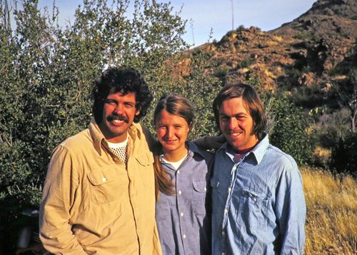
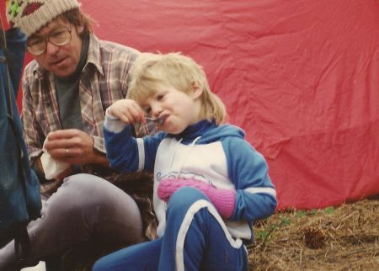
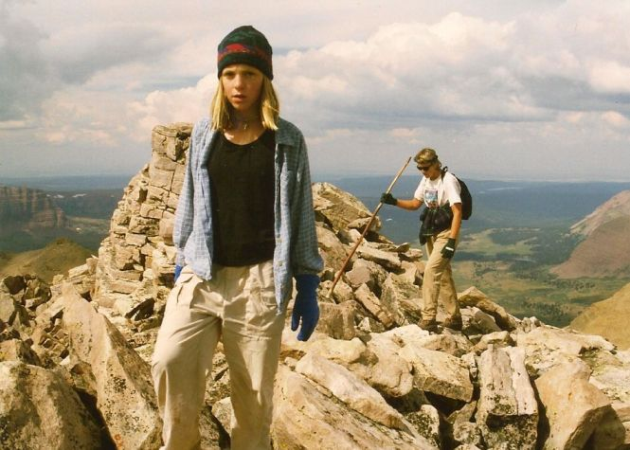
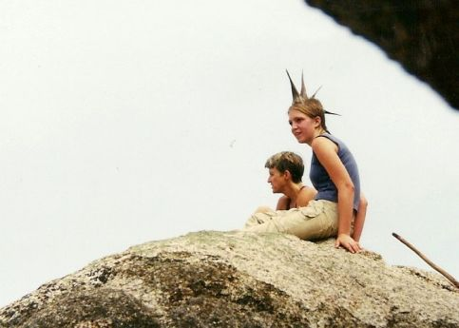
We’ve Always Gone to Wilderness
Superstition Wilderness, Arizona
Bryce Canyon Wilderness, Utah
Uinta Wilderness, Utah
Shenandoah Wilderness, Virginia
Notes:
Slide 5…We have always gone to the wilderness
We have always gone to the wilderness.
We met in a university hiking club; students Richard, Cindy and David became infamous for leading strenuous hikes.
We took our daughter to wilderness often…even during rebellious teen years!
Working in Nation’s capital, wilderness visits were great break from often frustrating careers working for federal bureaucracy.

Slide 6
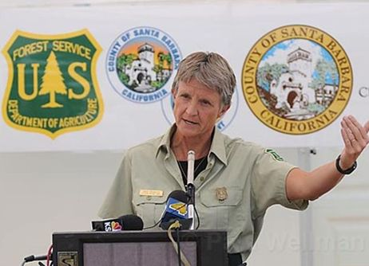
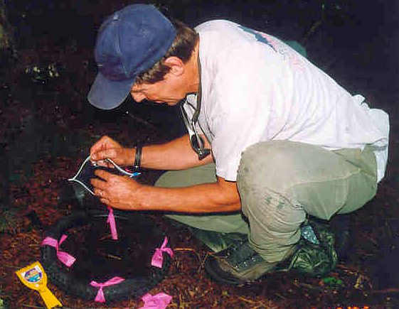
2014, Went to Wilderness Fulltime
Institutional barriers ended our natural resource careers
Cindy: journalist/ pr/ policy / District Ranger
David: forestry scientist
Nothing could stop us “going to wilderness”
Notes:
Slide 6…Wilderness became our work in 2014
We worked in natural resources, but institutional barriers ended our careers early.
Cindy was journalist/public affairs officer/ policy analyst and District Ranger with Forest Service.
I worked in forestry research with Forest Service, universities and on contracts.
We decided that “going to the wilderness” was something we could do on our own and not be stopped by institutional barriers.

Slide 7
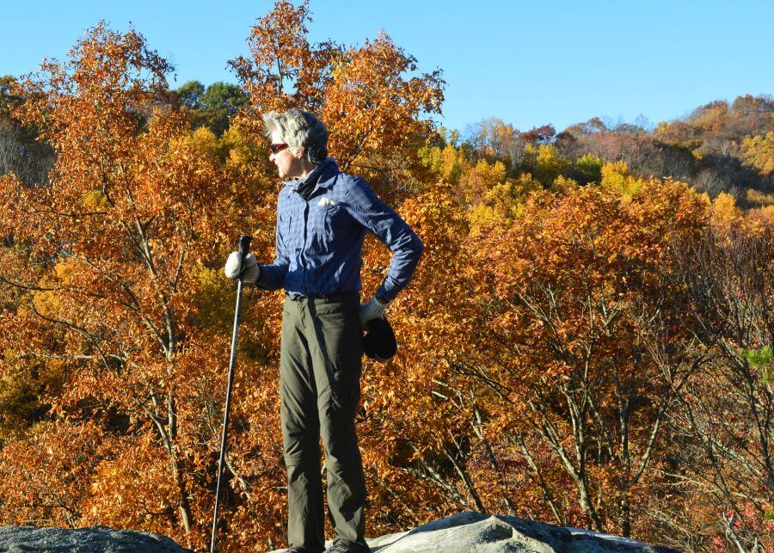
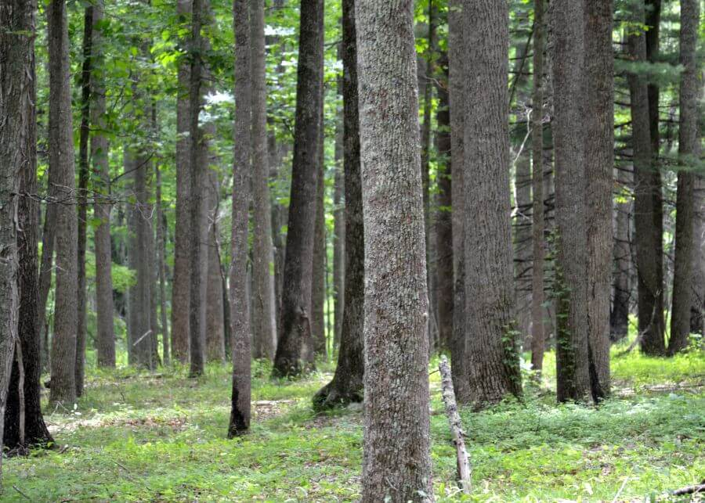
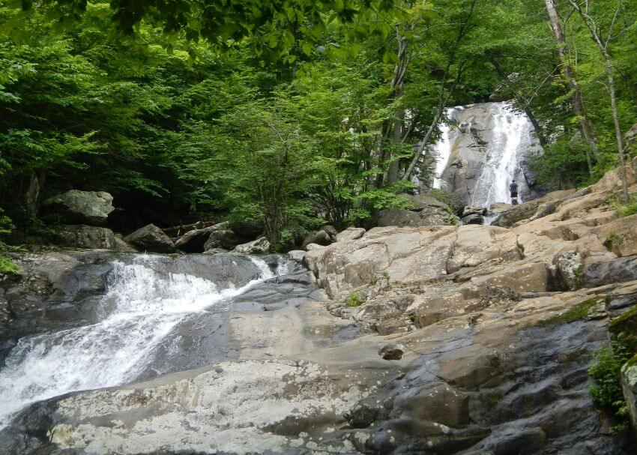
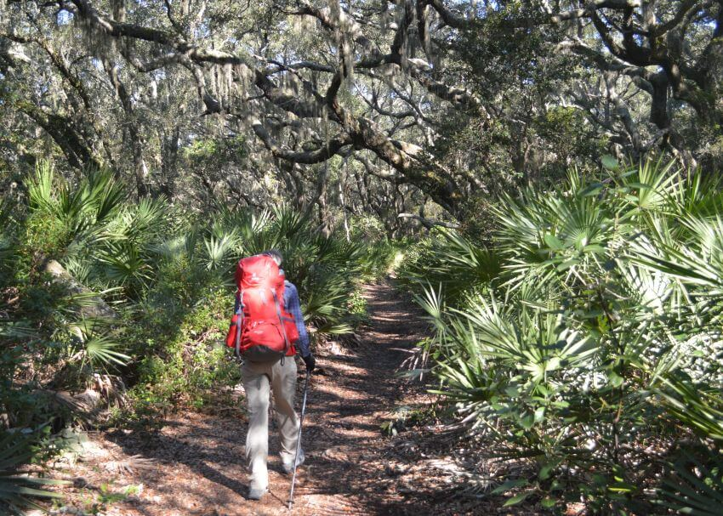
Started with Virginia Wilderness
Stone Mountain Wilderness
Barbours Creek Wilderness
Cumberland Island Wilderness, Gerogia
Shenandoah Wilderness
Notes:
Slide 7…Started with 24 Wilderness Areas in Virginia
We started in Virginia with goal to visit all 24 wilderness areas in state and write a book on it.
We completed the visit goal, but book was only drafted and never published.
We also visited other coastal wilderness areas in the eastern USA.

Slide 8
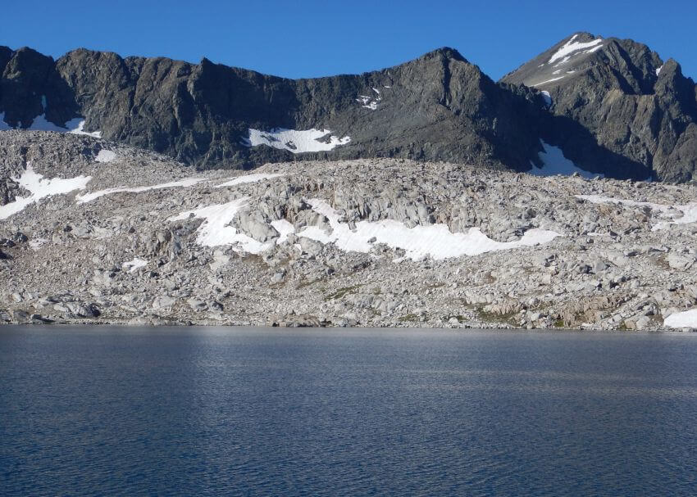
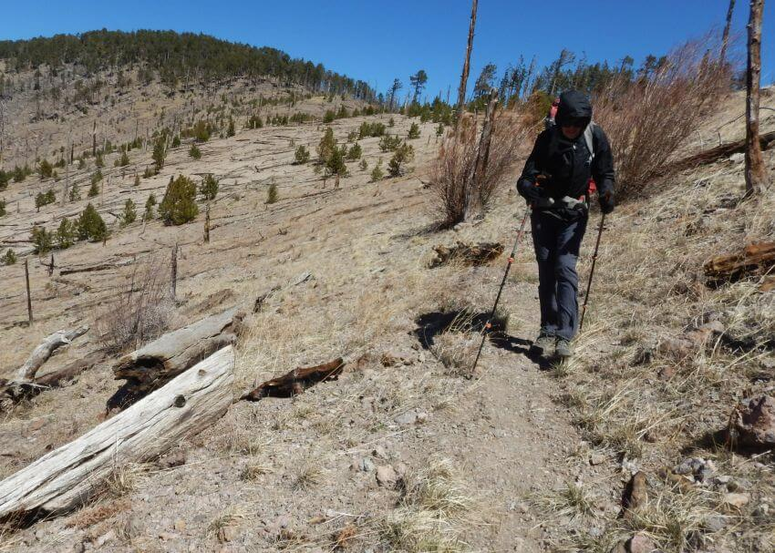
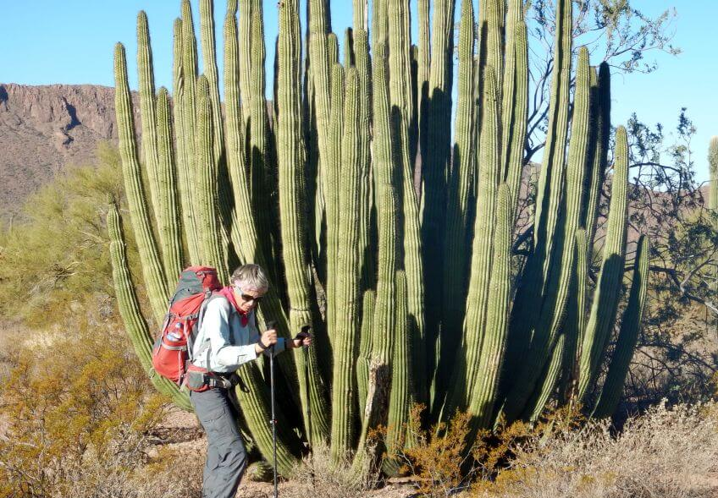
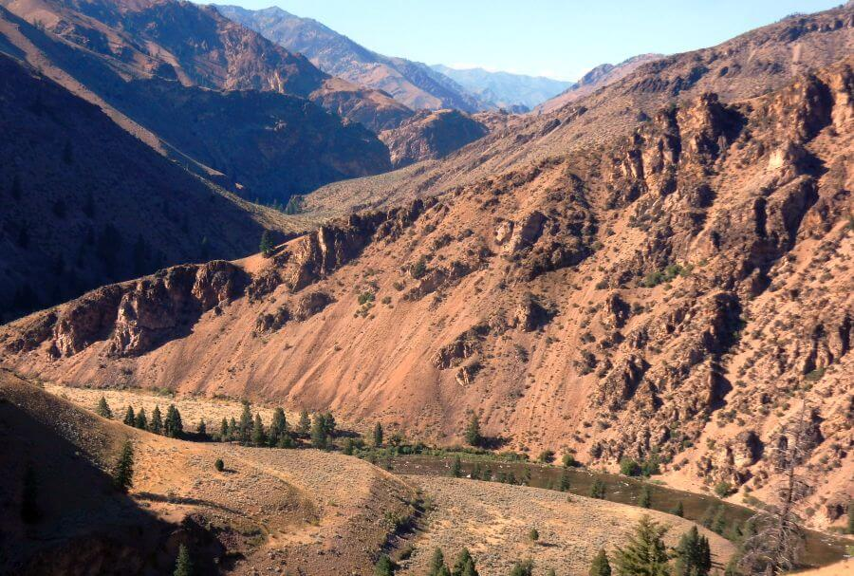
Have Visited 60 Wilderness Areas
Sequoia-Kings Canyon Wilderness, CA
Chiricahua Wilderness, Arizona
Organ Pipe Cactus Wilderness, AZ
Frank Church Wilderness, Idaho
Notes:
Slide 8…Have visited more than 60 wilderness areas…panel of four photos
After Virginia, we headed to western USA to primarily revisit wilderness areas first explored in your younger days.
So far we have visited 60 wilderness areas and are posting findings on our website.
Now Cindy, is going talk about some of our findings in context of the human interest and need for wilderness.

Slide 9
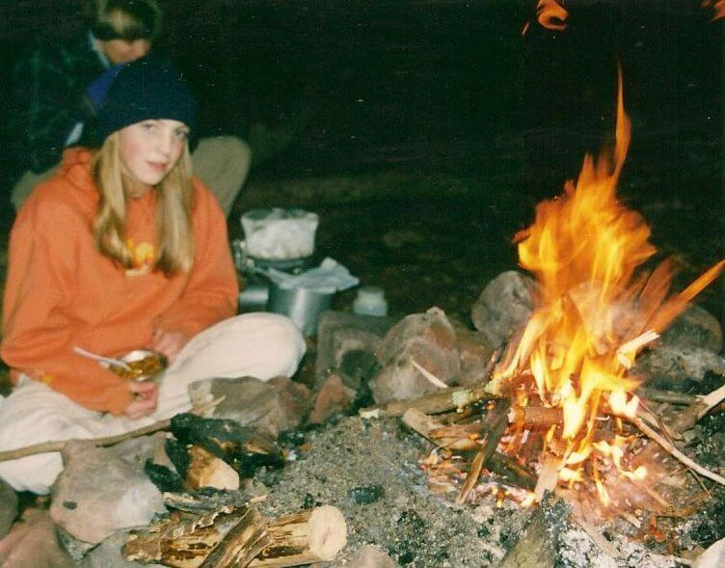
Why Go to Wilderness?
Beauty and power of natural world
Feeling “complete”
Relief from demands of culture
“Forest bathing”
Wilderness therapy
Doctor’s orders!
Notes:
Slide 9…why go to the wilderness?
Why do people go to the wilderness?
A couple of quotes:
National Outdoors Leadership School (NOLS) which offers long trips outdoors ran short interviews on “why wilderness.” This from a pre-med student who felt oppressed by pressures. “I Googled ‘wilderness’ and found my way to the NOLS website. I applied for a course in Alaska and was accepted...Witnessing the beauty and power of the natural world taught me many things; I realized how important it is that we fight to preserve these pristine places. I discovered that out there in the wild. Away from the world I was so accustomed to, I felt complete. Others who feel as I did must find a way to get out there.” https://matadornetwork.com/sports/why-were-drawn-to-the-wilderness-9-mini-interviews/
“Why tech generation needs wilderness therapy” (Outside magazine) In 2016 study called “30 Days Wild”, University of Derby (in England) and the Wildlife Trusts researchers asked 12,400 participants to engage with nature every day for a month. They found: …simply spending time in nature has positive impacts on physical health, e.g. reduced hypertension and respiratory and cardiovascular illnesses, as well as improved mood and reduced anxiety. In Japan, “forest bathing” is popular. In the United States, some doctors …are prescribing time in nature.” https://www.outsideonline.com/2336521/why-tech-generation-needs-wilderness-therapy

Slide 10
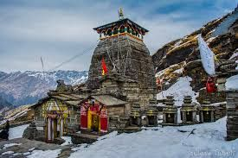
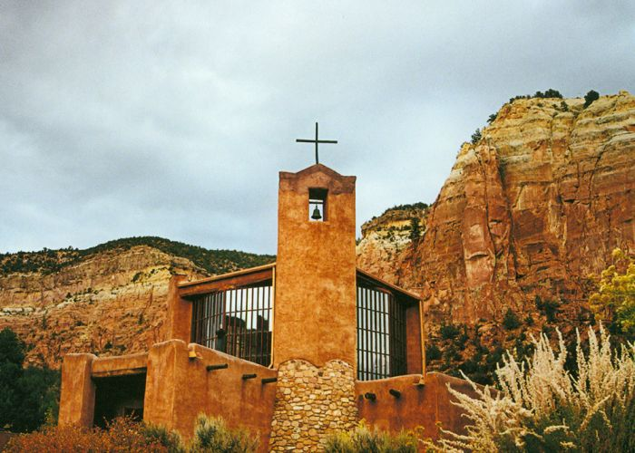
Wilderness a Spiritual Experience?
Judeo-Christian: God speaks in wilderness
Monasteries in wild places
All spiritual traditions recognize the Divine in Nature
Indigenous peoples: “Walkabout”
Notes:
Slide 10…Wilderness as a spiritual experience
Wilderness is a spiritual experience.
Judeo-Christian tradition includes wilderness: God leads the new nation Israel out of Egypt into the wilderness; Jesus goes into the wilderness to be tested and to be alone with God to pray. “Desert fathers,” first Christian monks went into desert in 3rd century.
Monasteries place to connect with Divine in the wilds: Hindu temple in Tongnath mountains in India. Benedictine Catholic monastery in New Mexico, USA.
Other spiritual traditions: Islam, B’hai, Hinduism, Janism & Buddhism teach that nature reflects the divine, and humans interdependent with all life.
Many indigenous spiritual traditions interweave humanity with nature. Australian aboriginal right-of-passage called Walkabout in wild areas. https://www.earthisland.org/journal/index.php/articles/entry/religions_need_wilderness/

Slide 11
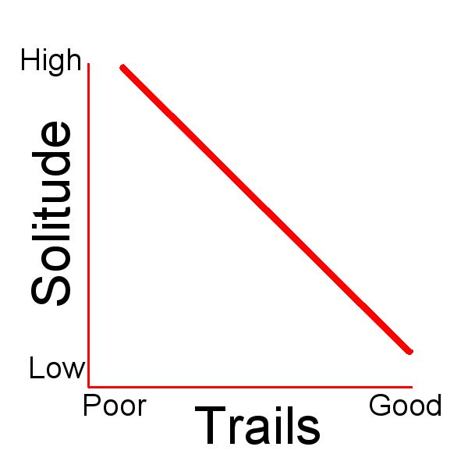
Shocking Finding From 320 days & 3,500 miles hiking wilderness
Much wilderness rarely used or known
But well-known areas heavily over-used
“Solitude-Trails-Inverse”: where trails & information good, solitude is low; where trails & information poor, solitude is high
Notes:
Slide 11…SHOCKING FINDING
From visiting USA wilderness we have found many areas rarely visited or not visited at all.
We are calling this a Solitude-Trails-Inverse: people flock to a few areas where information and trails are good and are loving these places to death, but where trails and information are poor—no people
Well known “through trails” like Appalachian Trail in East and John Muir Trail in Sierra Nevada mountains in West attract crowds but few people off the trail: adjacent Virginia wilderness or peripheral trails in High Sierras.
Most “through trails” have non-profit/ volunteer infrastructure for information and maintenance. While wilderness off beaten path usually have poor trails, outdated maps, and very little consistent information for planning.

Slide 12
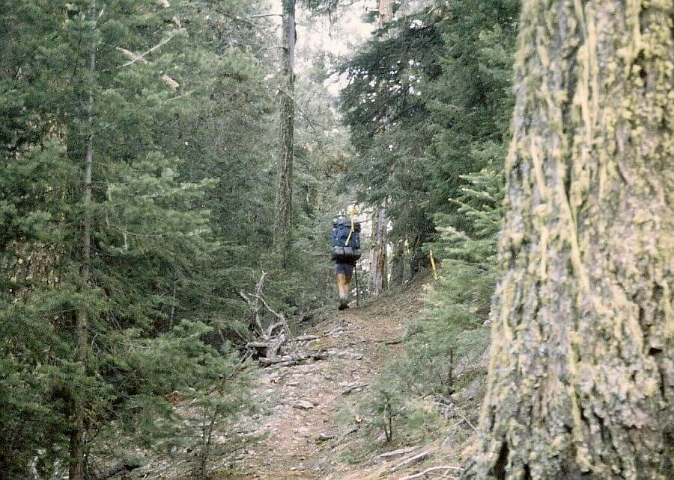
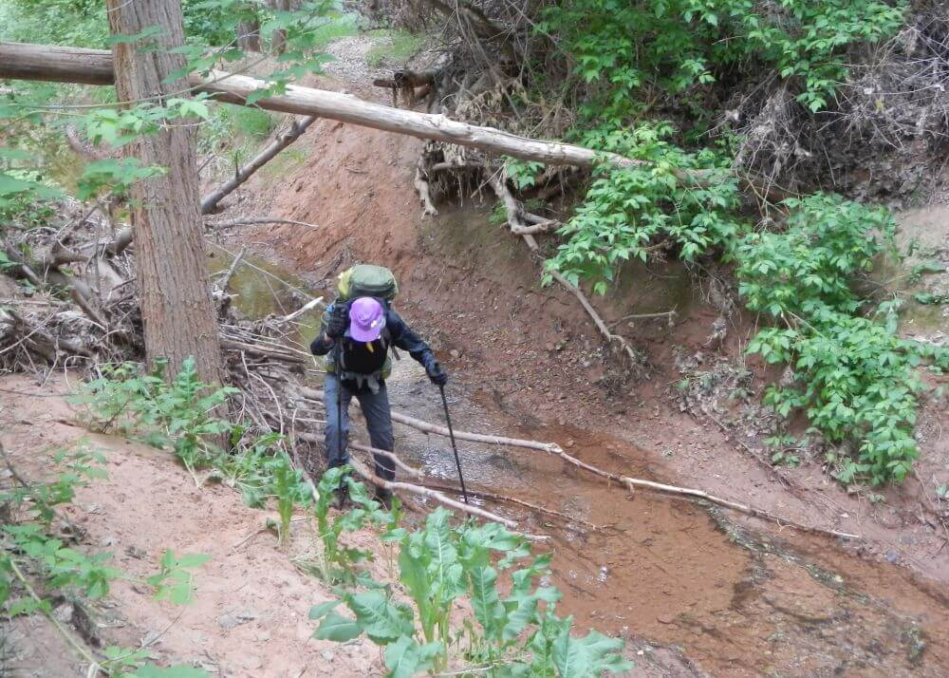
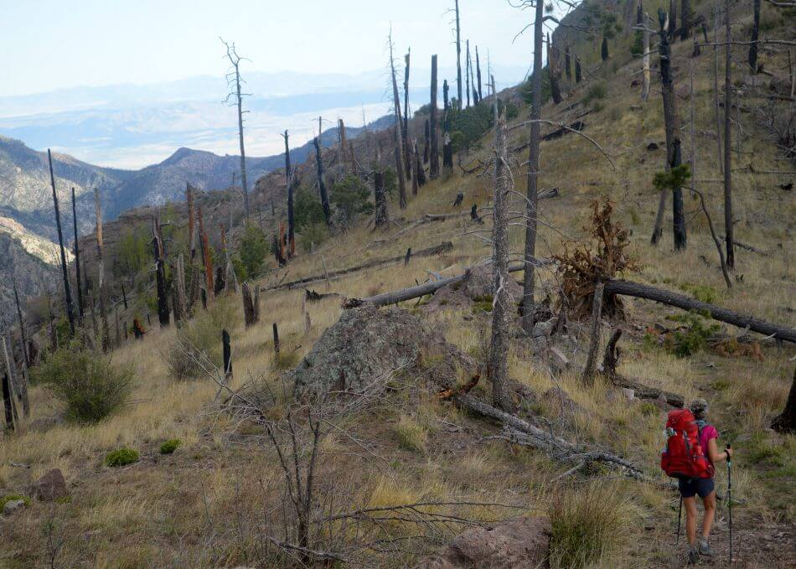
What happened?
Wilderness inherited legacy trails in 1964
Since 2000, climate change events altering trails
Legacy trail 1992 before 2011 fire
2019: flooding, erosion, & invasive species altered 1980s experince
Above trail in 2015 after megafire
Notes:
Slide12…What happened?
Most wilderness areas included in original Wilderness Act of 1964 had good trail system, but something has happened over past 60 years.
For first four decades, trails initially built for mining, logging or other access were maintained by federal agencies for field access and required minimal maintenance in temperate climate regime.
Since 2000, climate change has resulted in larger fires, more invasive species and pests, and extreme weather events rapidly changing wilderness environments and damaging trails.

Slide 13
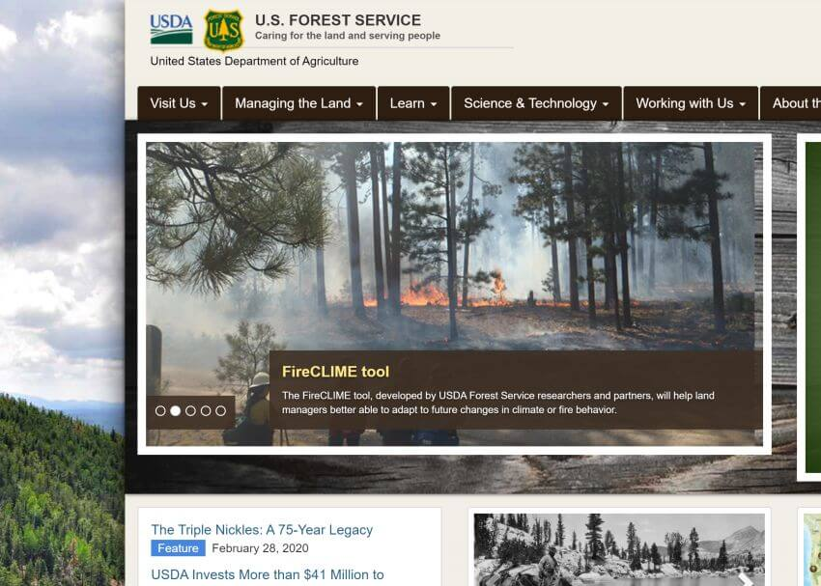
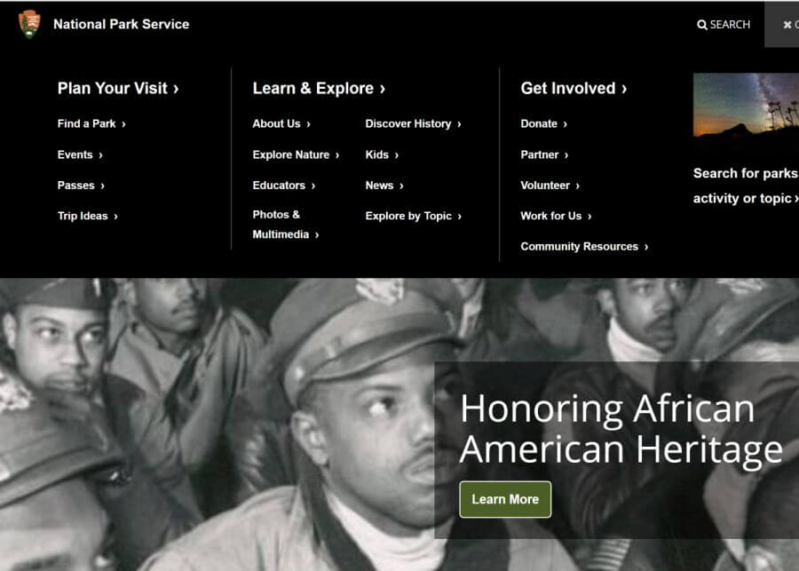
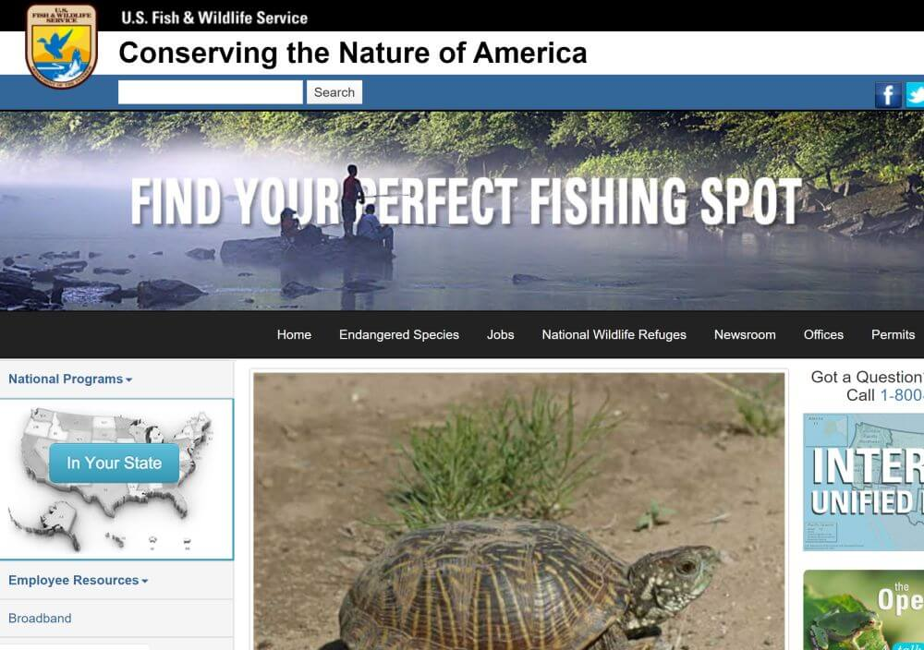
Distracted “Wilderness” Agencies
U.S. Forest Service
National Park Service
U.S. Fish & Wildlife Service
Bureau of Land Management
Notes:
Slide 13…Distracted “Wilderness” Management Agencies
Earlier, we mention that there are 4 USA agencies tasked with managing wilderness and maintaining trails for visitor “use and enjoyment.”
However, websites of the 4 wilderness management agencies show many priorities that proceeded wilderness including managing forests and/or wildlife, fire management, energy, dealing with multiple visitors.
Congress has also added many unfunded mandates such as civil rights, Homeland security and, environmental laws which require much more administrative (desk) work for process and litigation response—with relatively less resources for field personnel and work.
Add in declining federal domestic budgets in real dollars, USA may not be the ideal model for federal wilderness management.

Slide 14
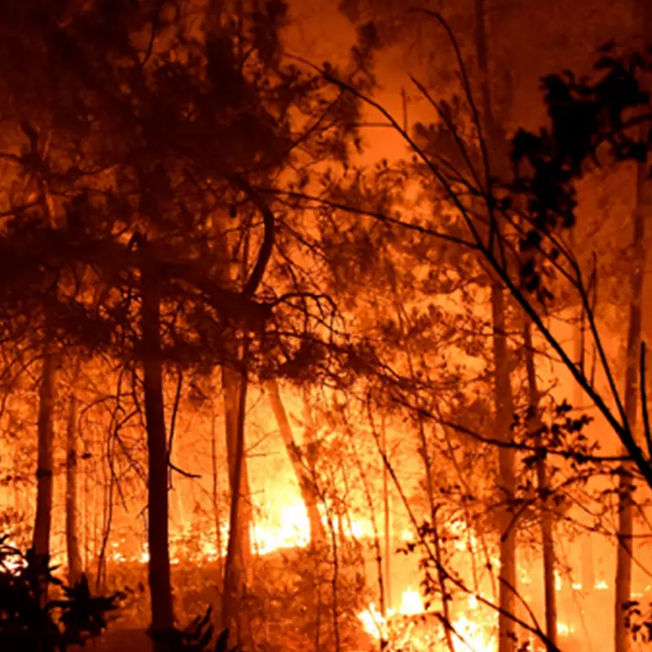
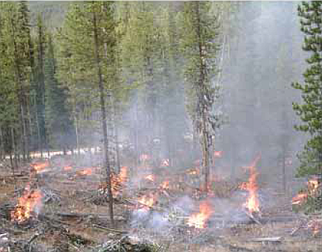
Fire and Fuels Distraction
Annual acreage of wildfires has more than doubled in 21st century since late 1990s
Current efforts to mitigate wildfire increase are costly fire-fuel treatments
Notes:
Slide 14…Fire and Fuels Distraction
Combating 21st century megafires has consumed much energy and funds of U.S. natural resource agencies.
Most new federal initiatives seem focused on fire-fuels mitigation with little opportunity for other needs such as improved wilderness management.

Slide 15
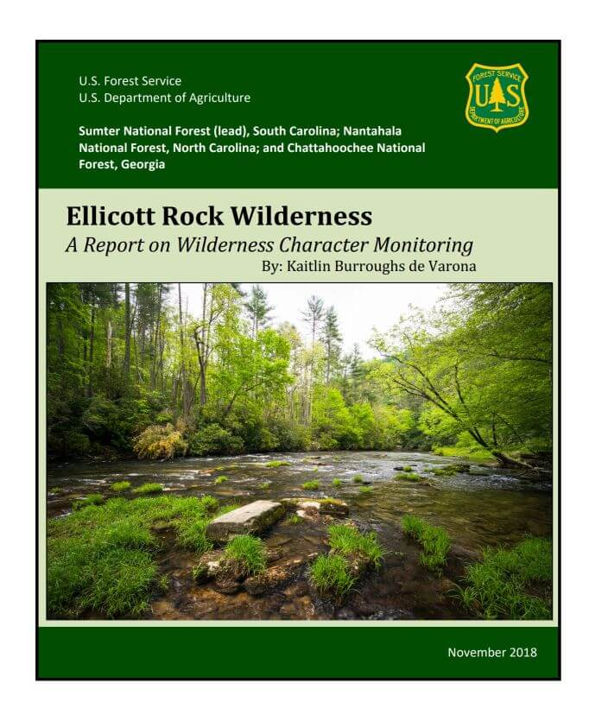
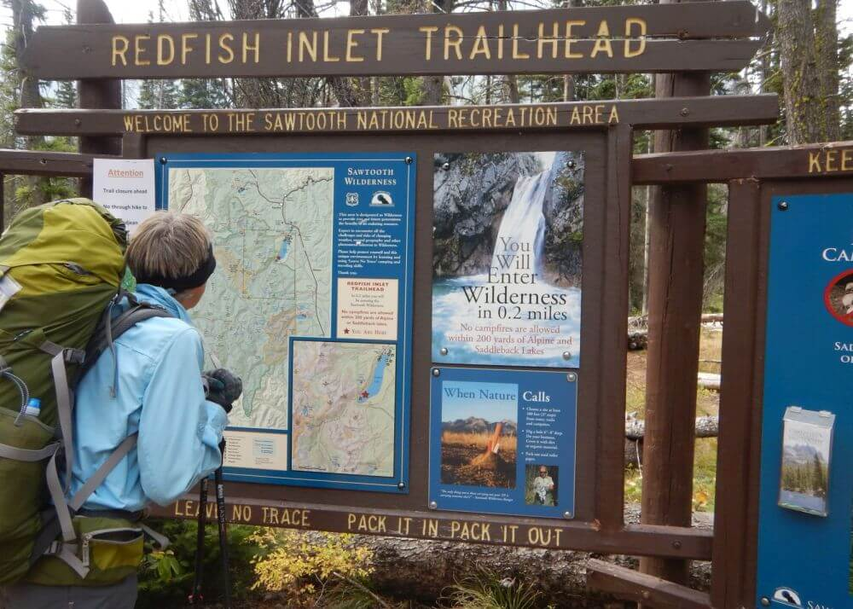
Wilderness Purpose Confusion
Lawsuits & policy push vague wilderness character definition
Energy going to wilderness character monitoring reports for each wilderness!
Unintended result: protect wilderness from visitors?
Many rules to protect, more important than trails and camping management to help visitor experience
Notes:
Slide 15…Wilderness purpose confusion
Finally we have observed confusion over “wilderness purpose” further distracting management agencies from trail or other work to help visitors
David mentioned tension in Wilderness Act between wilderness purpose (for use and enjoyment) and wilderness character (to ensure areas remain unimpaired).
Although “future public use and enjoyment” is the stated end or goal for wilderness management, wilderness proponents and lawsuits have shifted focus to what we call the means for wilderness management: “preserving areas unimpaired.” The focus is on wilderness character, a vague and poorly defined concept.
Agencies put energy into disparate time-consuming “wilderness character” narratives and monitoring for each wilderness. These offer no useful information on wilderness system trends nor on visitor use or needs.
This entrance portal to Sawtooth Wilderness shows many rules for protecting wilderness but no information on where to camp, tips to avoid overused areas, or other helpful hints for public enjoyment of wilderness.

Slide 16
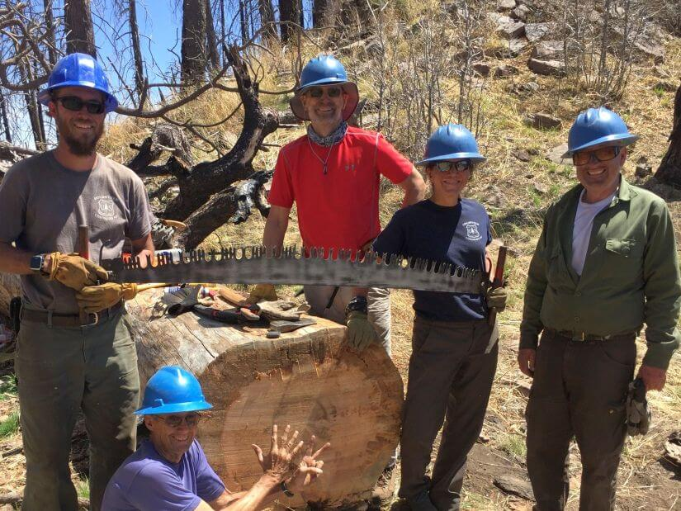
Is New Approach Needed?
USA wilderness status and management needs evaluation
Much effort went into wilderness establishment and protection…now need management shift
Small non-profit groups stepping into “trail maintenance” gap
But long-term comprehensive solution needed
Notes:
Slide 16…Designation/ protection focus = management by default
Most USA non-government organization (NGO) energy goes to fighting for more acreage or “protection” demands based on their own interpretation of Wilderness Act
Only small cadre of local volunteers / “Friends” groups concerned about access to wilderness and trail maintenance.
Objective on-going evaluation of wilderness status/management needed
USA National Wilderness System may need objective independent entity to do this evaluation and give oversight to manage wilderness and raise funds.

Slide 17
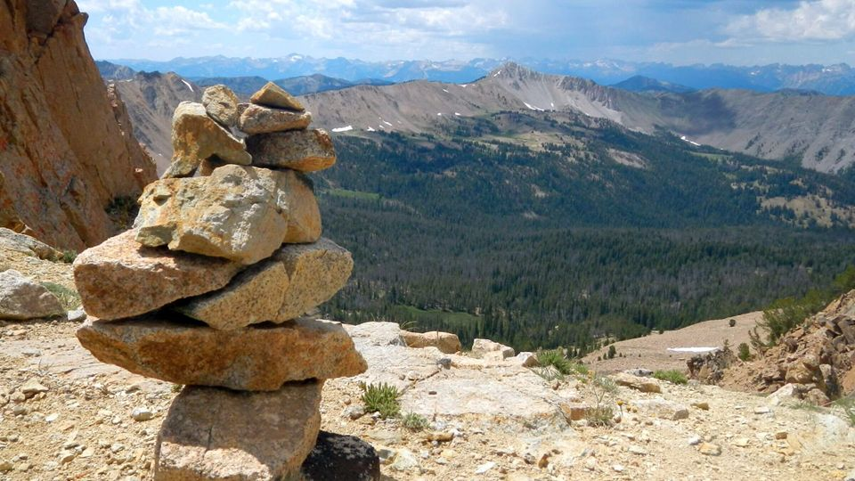
Questions/Comments?
Notes:
Slide 17…Questions/Comments
Now, we would like to hear your questions and comments.

